Slide 1







November 8, 2022
Information Session
11th Annual
Mid-Hudson Regional Business Plan Competition
hosted back In-Person at Marist College,
March 31, 2023
MHRBPC
http://bit.ly/2PY75zO
Competition Committee Contacts:
Cynthia Worrad cynthia.worrad@marist.edu 845-575-3611
Roberta Diggins roberta.diggins@marist.edu 845-575-3601
Thank you to our 2022 MHRBPC Sponsors
Notes:
Welcome Intro myself and Roberta
ZOOM protocols and Q&A – all mute except speaker host/co-host, type in “I have a question” and when called on participant UNMUTE, or type in question and we will be periodically checking and answer questions through out or at the Q&A session.
The purpose of tonight's session is to provide general information about the competition, how it works, what are the eligibility criteria, and get you excited to get started.
We will be holding another session next week on November 11called “Perfect Your Pitch and Mentoring Program information session” which will be focused on fine tuning your business plan and presentation ( or “pitch”), and provide information on the new Mentoring Program.
To Start off…..
The Mid-Hudson Regional Competition (MHRBPC), along with the New York State competition, represents a unique opportunity for entrepreneurial students to engage with business and government leaders, angel investors, venture capitalists and public investors, and get invaluable feedback for the potential launch of their business venture.
The MHRBPC is in it’s 9th year of being hosted by Marist College. The first 7 years the MHRBPC was held on Marist Campus in Poughkeepsie, but last year and this year it will be hosted virtually, along with the other regional competitions and the NYBPC.

Slide 2
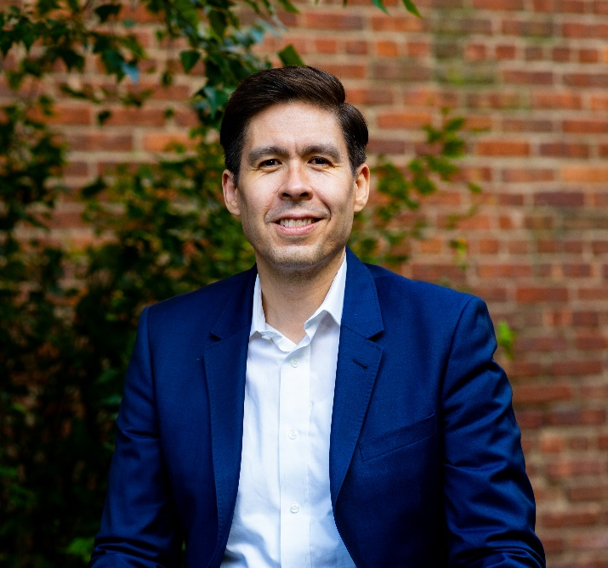


Guest Speakers
Alejandro Crawford
CEO
RebelBase
and
Clinical Professor of Entrepreneurship, MBA in Sustainability Clinical Professor of Entrepreneurship, MBA in Sustainability
Bard College
Aswan Carbonell
a business development lead at RebelBase

Slide 3

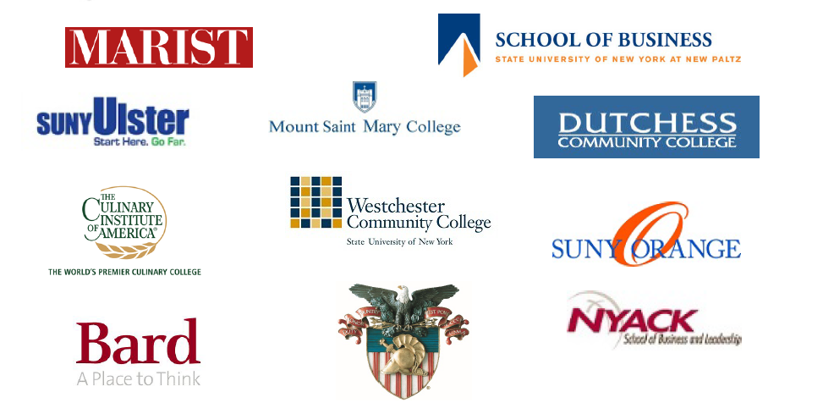







Past Regional Participant Schools:
PARTICIPANTS“No official U.S. Government or Service Academy endorsement is implied. The views and opinions expressed by this organization do not necessarily state or reflect those of the U.S. Military Academy, Department of the Army, or Department of Defense.”
Notes:
We have had student teams participate from a number of colleges and universities throughout the 7 counties in our region….some who were very successful and went on to compete and win at the State competition.
The Mid-Hudson regional competition is hosted by Marist College, but it is a regional event and it's a wonderful opportunity to showcase the creative business ideas and talents of students throughout the region. Many of these schools have champions, or active partners, of the event who have promoted the Competition at their institution and helped coordinate the event along with us.
We are excited to work once again with your school during this year’s competition, and hope to welcome new ones who have not participated before.

Slide 4
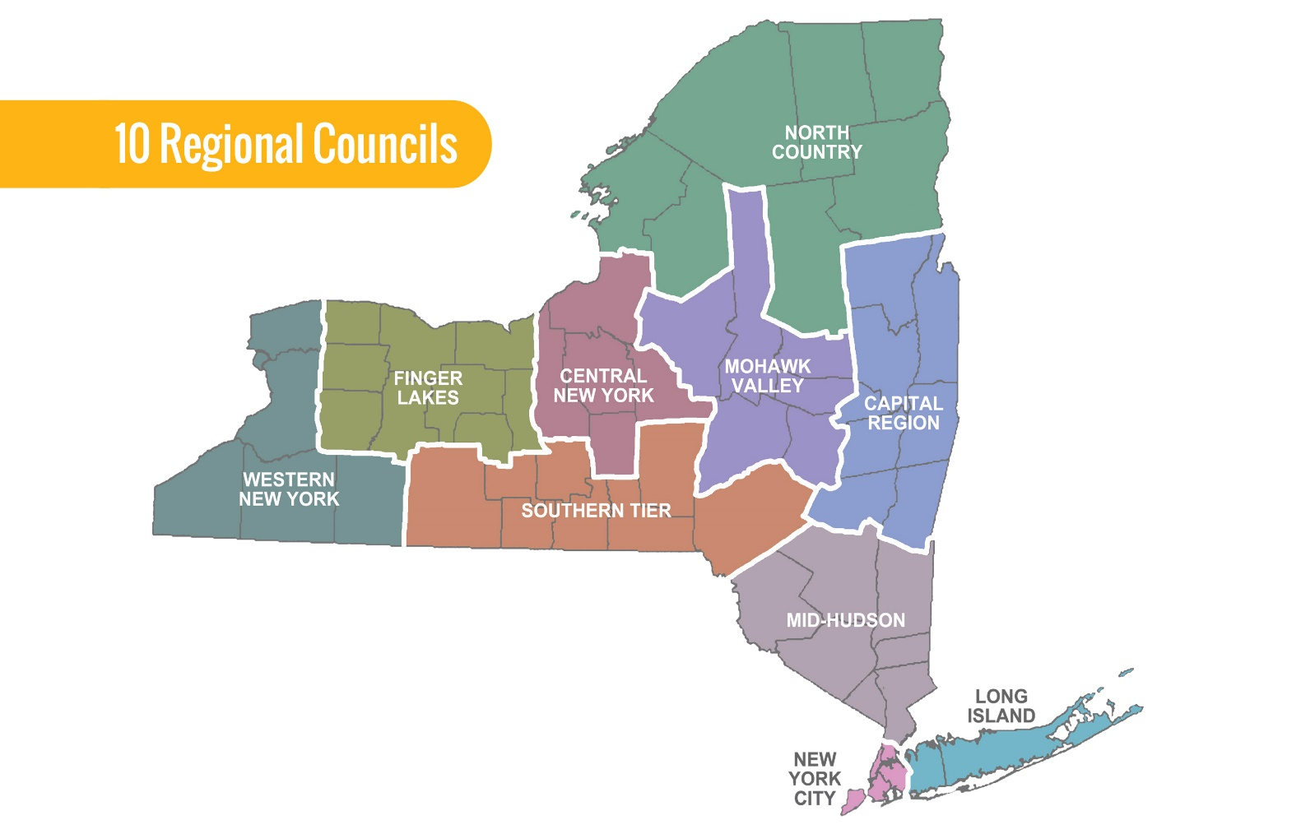
Background and Basics
The MHRBPC provides a platform for students to: share their business ideas, research the market and competitive landscape, complete financial projections, and compete for cash and in-kind prizes. Plus additional benefits: network, receive mentorship & advice, gain experience
Mid-Hudson Region: 7 Counties
Dutchess
Orange
Putnam
Rockland
Sullivan
Ulster
Westchester
10 Regions for the New York State Business Plan Competition based on New York’s ten Regional Economic Development Council zones.
Students will be assigned to a semifinal regional competition based on the
location of their school.
NYS Competition Established in 2010
Regional Expansion 2013
Captial Region | Mohawk Valley
Central New York | New York City
Finger Lakes | North Country
Long Island | Southern Tier
Mid-Hudson | Western New York
Notes:
The NYBPC’s mission is to provide a robust, fair competition for students across New York State to promote entrepreneurship and to start new ventures.
NYS is divided into 10 economic regions in which select regional institutions will host regional semifinal competitions in March/April 2021.
Students will be assigned to a semifinal regional competition based on the
location of their school. All semifinal competitions follow this rulebook and
rubric, but format and timing of the semifinal competitions vary.
Top teams from each region advance to the statewide final competition, be hosted virtually in April / May 2021.
The top 2 teams in each track at the regional level move on to the NYSBPC finals.
……the MHRBP provides a platform for students to:
share their ideas, research the market and competitive landscape, and complete financial projections
A regional business plan competition with a focus on energy technology was organized by : SUNY College of Nanoscale Science and Engineering (CNSE)
In partnership with: University of Albany School of Business
Lally School of Management and Technology at Rensselaer Polytechnic Institute
Union Graduate College School of Management
Inaugural event held at CNSE’s Albany Nanotech Complex
Encouraged students to fully engage in their research
Allowed students to fain valuable experience through presenting their business plans to potential investors an industry executives
Additional benefits:
• Ventures are able to showcase their business/technology to an audience of seasoned business professionals and investors
• Network with potential investors, service providers, strategic partners, and seasoned executives
• Network with other like-minded entrepreneurs from cross NYS
• Gain valuable experience

Slide 5
Background and Basics
NYS Competition History
2010: A regional business plan competition with a focus on energy technology was organized by SUNY College of Nanoscale Science and Engineering (CNSE)
In partnership with: University of Albany School of Business, Lally School of Management and Technology at Rensselaer Polytechnic Institute, and Union Graduate College School of Management
Inaugural event held at CNSE’s Albany Nanotech Complex
2013: Regional Expansion
Regional partner institutions host semifinal competitions in each of the regions every March/April
Top teams from each region advance to the statewide final competition
Since 2010, over….
6,000 Students have pitched their ideas
3,000 Teams participated in the NYS Business Competition
60 NY state colleges and universities
$150,000,000 of economic impact
$2,800,000 cash and in-kind prizes awarded
$45,000,000 raised by businesses launched
Notes:
The competition starts with students competing in all 10 regions across the state and culminates with finalists from each region competing at the state level for recognition and prize money in late April early May.
The Large statewide competition - NYBPC is New York’s premier collegiate regional & statewide business plan competition.
Regions based on New York’s 10 Regional Economic Development Council zones
So each region holds a competition and we send our winning teams to the state.
From a humble beginning of 16 teams in four schools, the state competition has since hosted an additional 164 teams from ten schools across the region.
The level of enthusiasm generated by the students has been enormous, and the judging panel has continued to grow and invest more time and energy helping the teams move forward with their business ventures.
Since 2010, over 4,000 students have pitched their ideas, and 2,800 teams have participated in the New York State Business competition More than $2,800,000 cash and in-kind prizes awarded. There are 132 ventures still active today. The economic impact for NYS and its student entrepreneurs is undeniable, as is the educational value for all participants.
……the MHRBP provides a platform for students to:
share their ideas, research the market and competitive landscape, and complete financial projections.
win cash or in-kind prize incentives which encourage students to move on to the process of completing a comprehensive business plan, and turning their ideas into reality.
Prize incentives also encourage greater participation from students across the seven-county region, exposing more students to the entrepreneurial process, while greatly enhancing the educational experience.
• Ventures are able to showcase their business/technology to an audience of seasoned business professionals and investors
• Network with potential investors, service providers, strategic partners, and seasoned executives
• Network with other like-minded entrepreneurs from cross NYS
• Gain valuable experience

Slide 6
General Competition Overview
Mid-Hudson Regional Business Plan Competition:
hosted by Marist College, in-person
March 1, 2023 – Student Teams Application Deadline
March 20, 2023 – Student Teams Video Pitch, Executive Summary and Slide Deck submission deadline
March 31, 2023 – In-person Pitch and Q&A, and Awards Ceremony
New York State Business Plan Competition:
April 18, 2023
- First Round: Regional Winners Final Video Pitch and Slide Deck submission deadline
April 27, 2023 – in-person in Syracuse, NY
– Second Round -Track Winners: Top Teams in Each Track Compete in-person in morning.
- Third Round - Grand Prize Finals: First Place Track winners Compete in-person in afternoon for grand prize.
11th Annual
Dates subject to change
(see NYBPC 2023 rulebook for updates and more details)
Notes:
Overview:
placed in tracks based category tags selected on application
MHRBPC ALL teams submit video and will present live
NYBPC all teams submit video, ONLY the top 10 teams in each track will be invited to pitch to a panel of finals judges with live Q&A.
Videos should only include the slide deck and presenter – no demos or footage of the product/service in
use in the field. This includes software demos. Screenshots and photos are welcome and encouraged.
Videos that do not match submitted slide decks will risk disqualification. To best align with judge expectations and the judging rubric, students should focus on creating a simple and clear presentation rather than a fancy video production.
PDF or PPTX format.
The first and second place winners from each track in each of the 10 regions advance to the State Finals Students compete within tracks
Students submit video pitch in advance and present to a panel of expert judges.
This is a 5-7 MINUTE Presentation with a 5 minute Q&A

Slide 7
General Competition Overview
Mid-Hudson Regional Business Plan Competition:
hosted by Marist College
11th Annual
Students complete one unified BPC application - available Jan. 2023 on NYBPC.org and the MHRBPC Website . Application Deadline March 1, 2023
Students compete within tracks (assigned by NYBPC organizers)
Students submit a 6-8-minute video pitch, slide deck and executive summary on RebelBase platform – by March 23, 2023
Students present to a panel of expert judges in-person – on March 31, 2023
  8-minute pitch presentation, plus 6 minutes for Q&A
The 1st and 2nd place winners from each track in each of the 10 regions
advance to the State Finals
  (up to 12 teams per region and 120 teams in total)
All MHRBPC Teams Present in-person for the MHRBPC
Select teams per track present in-person for the NYBPC
(see NYBPC 2023 rulebook for updates and more details)
Notes:
Overview:
placed in tracks based category tags selected on application
MHRBPC ALL teams submit video and will present live
NYBPC all teams submit video, ONLY the top 10 teams in each track will be invited to pitch to a panel of finals judges with live Q&A.
Videos should only include the slide deck and presenter – no demos or footage of the product/service in
use in the field. This includes software demos. Screenshots and photos are welcome and encouraged.
Videos that do not match submitted slide decks will risk disqualification. To best align with judge expectations and the judging rubric, students should focus on creating a simple and clear presentation rather than a fancy video production.
PDF or PPTX format.
The first and second place winners from each track in each of the 10 regions advance to the State Finals Students compete within tracks
Students submit video pitch in advance and present to a panel of expert judges.
This is a 5-7 MINUTE Presentation with a 5 minute Q&A

Slide 8
Eligibility Requirements
Open to all currently enrolled graduate and/or undergraduate students from accredited New York State colleges and universities in the Mid-Hudson region.
Eligible Student(s) must be the presenter(s) in all stages of the competition
Teams may compete in only 1 region per year, based on school location.
Students may not participate on more than 1 team each year of the competition.
Grand prize winners from previous years’ competitions are no longer eligible to compete in the competition.
  They are encouraged to participate as speakers, mentors, volunteers, and judges!
Individual members of winning teams may return with new teams in subsequent years.
(see NYBPC 2023 rulebook for updates and more details)
Notes:
Team Criteria:
it's open to all “Students” are any graduate, undergraduate, and/or community college students enrolled part- or full-time in accredited New York colleges and universities during the current
academic year. Students who graduate during the Fall semester are still eligible to compete in the competition during the Spring semester
Student(s) must be the presenter(s) in all stages of the competition
Teams may compete in only one region per year, assigned to region based on school location (NEW 2021).
Students may not participate on more than 1 team each year of the competition.

Slide 9
Eligibility Requirements
Teams with Incorporated Ventures
Cumulative public and private capital raised may not exceed $100,000
Student ownership of venture must be more than 50%
(see NYBPC 2023 rulebook for updates and more details)
Notes:
Teams with Incorporated Ventures
Cumulative public and private capital raised may not exceed $100,000**
Student ownership of venture must be 80%
Another common question that we get is can I be on two different teams?
can I work with this group of students on social entrepreneurship and can I work with this group of students into an app? The answer is no. You can only be on one team for the competition.
Students may not participate on more than 1 team each year of the competition
* Cumulative public and private capital raised may not exceed $100,000 (This does not include research funding that may have supported the development of the technology in an academic laboratory.)
*Student ownership of venture must be 80%
You cannot as a team, have raised more than a hundred thousand dollars in capital prior to joining the competition . Now, is that gonna be a problem for anyone? you never know it could be but you should not have raised already over a hundred thousand dollars. Again you have to it has to be 80 percent student owned.
There are many questions that are not necessarily covered by this slide that people come up with, if you ever have a question send it to me by email you have my email address on that little black card and if I can't answer it because we have to we're guided by New York State's rules the state competition
if I don't know the answer I will contact my folks at the state level and get you an answer which will comeback from the ethics committee

Slide 10
Six Tracks
Each business venture will be placed in a competition Track by business plan organizers based on category tags selected on the business plan competition application. Student Teams will compete against other teams that fit into a specified competition Track.
Safety, Power & Mobility
Health & Wellbeing
Food and AgTech
Products & Hardware
Services & Software
Learn, Work & Play
Notes:
Track Definitions
Will be announced March 1, 2021
● Students will no longer select a track on their applications, but will instead select one or more category tags. These tags may align with the track definitions or with special prize definitions or with neither.
Student teams will be informed of their track assignments prior to the regional competitions
Students teams will be placed in track based on category tags selected on student team application to BPC
To keep pace with our rapidly changing world and to provide a balanced
competition, track definitions will be finalized and announced on March 1, 2021.
● Teams in each of the tracks may represent for-profit or non-profit.

Slide 11
Student Application Category Tags
Student teams will choose category tags for (1) Sectors,(2) Business Types, and (3) Tags to help to identify the track that is the best fit for their business venture when completing the business plan competition application. Based on category tags selected, business ventures will be placed in a competition Track by the NYBPC organizers. Category tags can align with special prizes.
Possible CATEGORY TAGS
Sectors
Defense
Renewable Energy
First Responder
Mobility & Transportation
Education
Health
MedTech
Agricultural Tech
Food Product
Entertainment
Art
Business Type
Software
Hardware
Product
Service
Other B2B Solutions
Other B2C Solutions
Tags
BIPOC
Female Founder
First-Generation College Student
Immigrant Founder
LGBTQIA+
Social Entrepreneurship
Veteran Owned
Artificial Intelligence (AI)
Concept Stage
Notes:
Category Tags
Student teams will choose 1 or more category tags when completing the application for the BPC
Category Tags could be related to the type of business, attributes of the team, the type of
product or service, or target markets or customers.
Business venture will be placed in competition Track based on category tags selected.

Slide 12
Judging Criteria
For more details
See Rulebook on NYBPC.org
MARKET OPPORTUNITY: Clear market need and a plan to take advantage of the need.
COMPETITIVE ADVANTAGE: The product or service is something unique that has a protectable competitive advantage in the proposed market.
MANAGEMENT CAPABILITY: The team has the skills and experience to develop this venture and address the associated risks.
FINANCIAL UNDERSTANDING: The team has a solid understanding of the financial requirements of the venture.
ROADMAP/GROWTH STRATEGY: The team has engaged in short and long-term planning and has considered strategies for growth.
SUSTAINABLE BUSINESS MODEL: The team understands & can communicate their core business model & has a strategy for developing a sustainable venture.
Notes:
Judges are asked to evaluate companies according to the following criteria:
● Market Opportunity: Clear market need and a plan to take advantage of the need.
● Competitive Advantage: The product or service is something unique that has a protectable competitive
advantage in the proposed market.
● Management Capability: The team has the skills and experience to develop this venture and address
the associated risks.
● Financial Understanding: The team has a solid understanding of the
financial requirements of the venture.
● Roadmap/Growth Strategy: The team has engaged in short and long-term
planning and has considered strategies for growth.
● Sustainable Business Model: The team understands and can communicate
their core business model. They have a strategy for developing a sustainable
venture.

Slide 13
Presentation Content
For more details
See Rulebook on NYBPC.org
BUSINESS MODEL AND TEAM:
  GENERAL DESCRIPTION: What is your business model?
    What is the problem you are solving?
    Describe how your venture makes money and how it will assure great and long-term sustainability for the future.
  VALUE PROPOSITION: What is your company’s key value proposition?
    Why your business rather than the competitors? (e.g. lowest cost, highest reliability, best performance, etc.)? What is your venture’s right to win versus the competition?
    What are the benefits of your products or services?
  STRUCTURE: What is the structure of your company?
    Do you have the team members that you need to grow the business?
    How will the structure change with growth?
PRODUCT/SERVICE
  PRODUCT AND SERVICE: What is your product/service offering?
  FUNCTION AND BENEFIT: How does your product/service work? Define and quantify key benefits (e.g. cost, performance, technical, etc.) for customers.
  DEVELOPMENT PROCESS: Where is the product/service in its evolution (e.g. idea/conception, proof of concept, fully tested prototype, etc.)?
Notes:
It is recommended that you seek to address the following questions in your presentation
Business Model and Team
1. Structure: What is the structure of your company? Do you have the team members that you
need to grow the business? How will the structure change with growth?
2. Value Proposition: What is your company’s key value proposition (e.g. lowest cost, highest
reliability, best performance, etc.)?
A value proposition tells prospects why they should do business with you rather than your competitors, and makes the benefits of your products or services crystal clear from the outset.
3. General Description: What is your business model? Describe how your business makes money
and how it will assure great and long term sustainability for the future.
Product/Service
1. Product/Service: What is your product/service offering?
2. Function and Benefit: How does your product/service work? Define and quantify key benefits
(e.g. cost, performance, technical, etc.) for customers.
3. Development Stage: Where is the product/service in its evolution (e.g. idea/conception, proof
of concept, fully tested prototype, etc.)?
Competitive Position
1. Competitors: Who is your competition?
2. Edge over Competition: What makes you better than other companies currently in the market?
3. Sustainability: Is this competitive position sustainable?
4. IP Protection: How will you protect your proprietary information?
Markets
1. Target Market: What markets and market segments are you targeting? How big are these
markets and how can you sustainably capture them?
2. Barriers to Entry: What are the key market barriers and how will they lend to your success?
Customers
1. Customers: Who are the specific customers that you are pursuing or will pursue? Do you have
any letters of interest and/or intent to purchase?
Do you have any actual sales to date?

Slide 14
Presentation Content
For more details
See Rulebook on NYBPC.org
COMPETITIVE POSITION:
  COMPETITORS: Who is your competition?
  EDGE OVER COMPETITION: What makes you better than other companies currently in the market?
  SUSTAINABILITY: Is this competitive position sustainable?
  IP PROTECTION: How will you protect your propriety information?
MARKETS:
  TARGET MARKET: What markets and market segments are you targeting? How big are these markets and how can you sustainably capture them.
  BARRIERS TO ENTRY: What are the key market barriers and how will they lend to your success?
CUSTOMERS:
  CUSTOMERS: Who are the specific customers that you are pursuing or will pursue? Do you have any letters of interest and/or intent to purchase? Do you have sales?
  DISCOVERY: What kind of customer discovery have you conducted to find out about people who want what you are offering?
Notes:
It is recommended that you seek to address the following questions in your presentation
Business Model and Team
1. Structure: What is the structure of your company? Do you have the team members that you
need to grow the business? How will the structure change with growth?
2. Value Proposition: What is your company’s key value proposition (e.g. lowest cost, highest
reliability, best performance, etc.)?
A value proposition tells prospects why they should do business with you rather than your competitors, and makes the benefits of your products or services crystal clear from the outset.
3. General Description: What is your business model? Describe how your business makes money
and how it will assure great and long term sustainability for the future.
Product/Service
1. Product/Service: What is your product/service offering?
2. Function and Benefit: How does your product/service work? Define and quantify key benefits
(e.g. cost, performance, technical, etc.) for customers.
3. Development Stage: Where is the product/service in its evolution (e.g. idea/conception, proof
of concept, fully tested prototype, etc.)?
Competitive Position
1. Competitors: Who is your competition?
2. Edge over Competition: What makes you better than other companies currently in the market?
3. Sustainability: Is this competitive position sustainable?
4. IP Protection: How will you protect your proprietary information?
Markets
1. Target Market: What markets and market segments are you targeting? How big are these
markets and how can you sustainably capture them?
2. Barriers to Entry: What are the key market barriers and how will they lend to your success?
Customers
1. Customers: Who are the specific customers that you are pursuing or will pursue? Do you have
any letters of interest and/or intent to purchase?
Do you have any actual sales to date?

Slide 15
Sample Presentation Format
Company Name / Logo at the top of each slide (suggest 10-15 slides max)
Mission and Purpose
Business Model
Product/Service
Competitive Position
Markets
Customers
People
  Management team and relevant experience especially that which is related to start-ups
  Industry experience
  Other key people and advisors
  Number, mix and capabilities of employees
Financials
  Current sales/sales anticipated in 3 years, 5, 10 (pricing and volume)
  Margins
  Relative to financing needs
    How much is needed
    How will it be used
    How it will be repaid to investors and/or debtors (if applicable)
Achievements to date
  Important milestones
  Next Steps
For more details
See Rulebook on NYBPC.org

Slide 16
Example Presentations
For more details
See Rulebook on NYBPC.org
From the 2022 NYBPC
Photonect: Juniyali Nauriyal and Sushant Kumar, University of Rochester (2022 Grand Prize)
Step2,3 LLC: Shannon Sincere Dawson, SUNY at Purchase College (2022 GRYT Health Award)
Bio-Spire: Tiana Salomon, University of Rochester (2022 1st Place Track Winner)
From the 2020 MHRBPC
NightCap Christina Bryde, MHRBPC (2020 MHRBPC 1st Place AgTech and Food Track Winner, and NYBPC 2nd Place AgTech and Food Track Winner)
Notes:
Judges are asked to evaluate companies according to the following criteria:
● Market Opportunity: Clear market need and a plan to take advantage of the need.
● Competitive Advantage: The product or service is something unique that has a protectable competitive
advantage in the proposed market.
● Management Capability: The team has the skills and experience to develop this venture and address
the associated risks.
● Financial Understanding: The team has a solid understanding of the
financial requirements of the venture.
● Roadmap/Growth Strategy: The team has engaged in short and long-term
planning and has considered strategies for growth.
● Sustainable Business Model: The team understands and can communicate
their core business model. They have a strategy for developing a sustainable
venture.

Slide 17
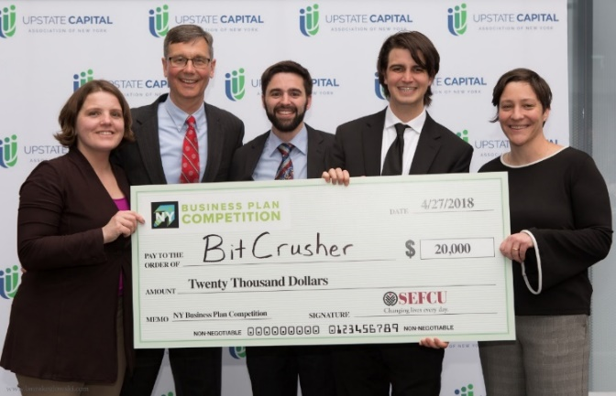
Prizes
Depending on 2023 NYBPC sponsorship, Prize Money may be awarded at the regional competition to the top two teams from each track. To be announced at Marist College on March 31, 2023.
A maximum of two teams from each of the tracks from each region will be invited to the statewide final competition hosted over 3 rounds, between April 18 – 27, 2023, with the Grand Finale Celebration on April 27, 2023, in Syracuse, NY.
What’s up for grabs at the state level?
  In past years there was over $500,000 in cash and in-kind prizes
  Past grand prize-winning teams have taken home over $100K in cash and in-kind services. 2023 Grand Prize Team will receive $30,000!
Notes:
The winners the top two teams from each category are invited to compete at New York State .

Slide 18
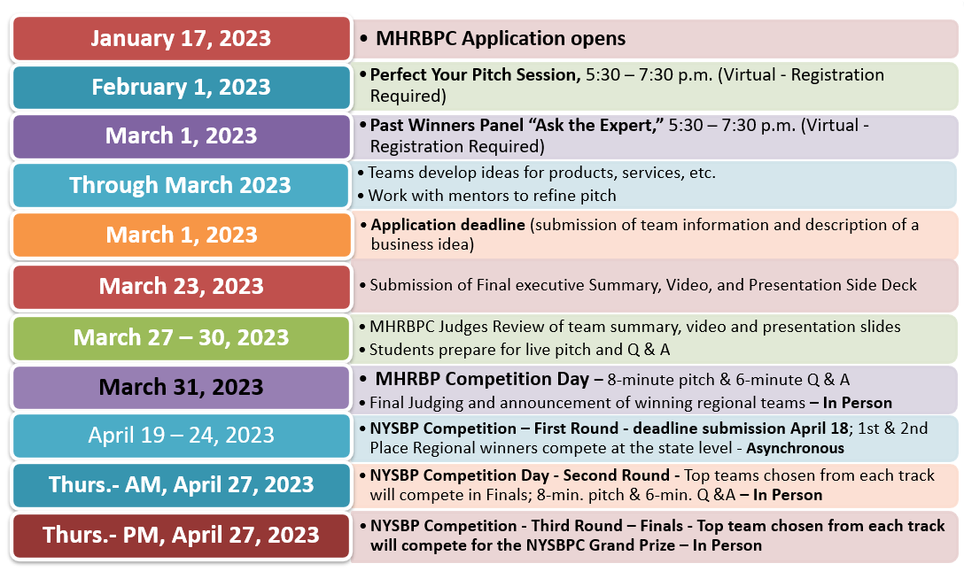
2023 MHRBPC & NYBPC Timeline
Subject to change
Notes:
When applications open we will post on website and send out email of notification

Slide 19
APPLYING
Student Online Application
Opens: January 2023
Deadline: March 1, 2023
Check the website for the link to apply (must apply to participate)
Student Executive Summary, Slide Deck and Video Submission
Deadline: March 23, 2023
Submissions loaded on RebelBase platform
  (students receive sign-in information for RebelBase after competing application)
MHRBPC: http://bit.ly/2PY75zO
https://www.marist.edu/computer-science-math/mid-hudson-regional-business-plan-competition
NY state: https://www.nybpc.org/
Notes:
Basically right now, you're just developing your idea you're getting it ready. You're flushing the idea out. The application deadline is going to be March 19, 2021
At this time, you should just be working on getting it all together.
The application process is quite simple. it amounts to the equivalent of a two-page word document, but you're going to submit it online.
From the website there will be a link for team application button. You will be able to submit your application, then committee review and and you will be notified of acceptance
Do I need a bound 32-page business plan for the competition? NO, 2 pages

Slide 20
11th Annual
Mid-Hudson Regional Business Plan Competition:
hosted at Marist College, Poughkeepsie, NY
MARCH 31, 2023
http://bit.ly/2PY75zO
MHRBPC Website
Competition Committee Contacts:
Cynthia Worrad cynthia.worrad@marist.edu 845-575-3611
Roberta Diggins roberta.diggins@marist.edu 845-575-3601
Thank you and short Q&A,
before we move on to our guest speakers
Notes:
Thank you. Check our website often for updates and information

Slide 21
Guest Speakers
Alejandro Crawford
CEO
RebelBase
and
Clinical Professor of Entrepreneurship, MBA in Sustainability Clinical Professor of Entrepreneurship, MBA in Sustainability
Bard College
Aswan Carbonell
a business development lead at RebelBase

Slide 22
“Perfect Your Pitch”
& Mentoring Program Information Session
Visit the MHRBPC website for more information ….
February 1, 2023
MHRBPC
http://bit.ly/2PY75zO

Slide 23
“Ask the Experts”
Panel
Watch for more information ….
March 1, 2023
MHRBPC
http://bit.ly/2PY75zO

Slide 24
11th Annual
Mid-Hudson Regional Business Plan Competition:
hosted at Marist College, Poughkeepsie, NY
MARCH 31, 2023
http://bit.ly/2PY75zO
MHRBPC
Check our MHRBPC Website for updates often.
Sponsorship opportunities at various levels.
Contact Competition Committee with Questions:
Cynthia Worrad cynthia.worrad@marist.edu 845-575-3611
Roberta Diggins roberta.diggins@marist.edu 845-575-3601
Thank you for attending!
Notes:
Thank you. Check our website often for updates and information

