Slide 1
Marist College Computer Store -Online
Tiffany Macdonald
Coordinator
845-575-3556
www.Marist.edu/computerstore

Slide 2
Marist College Computer Store -Online
The Computer Store has moved to the cloud!
All purchases must be made on-line - www.marist.edu/computerstore.
When you are ready to buy a new laptop for your student, we strongly encourage you to purchase one of the recommended models featured on the Computer Store’s website.
Other technology related items can be purchased at the Bookstore or other retail locations.

Slide 3
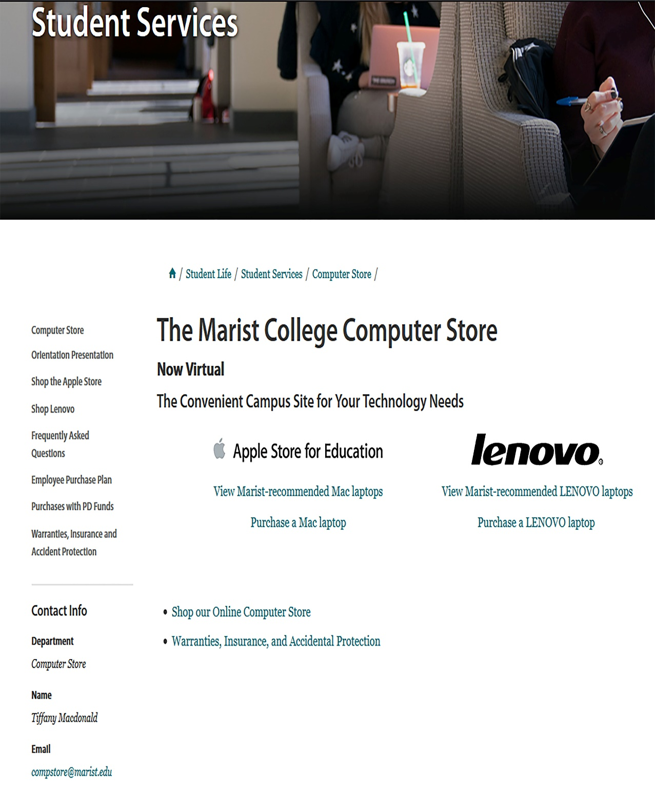
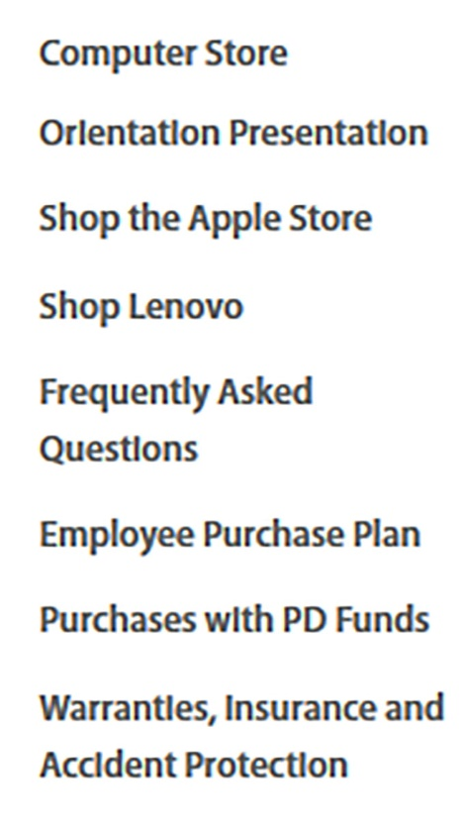
www.Marist.edu/computerstore
How to Shop @
Computer Store -Online
Laptops (purchased online only)

Slide 4
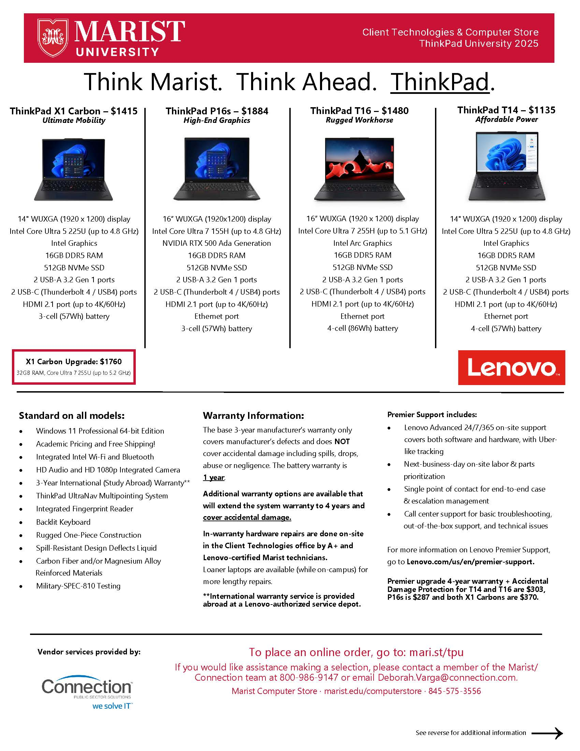
Recommended
ThinkPad University
Lenovo laptops with details

Slide 5
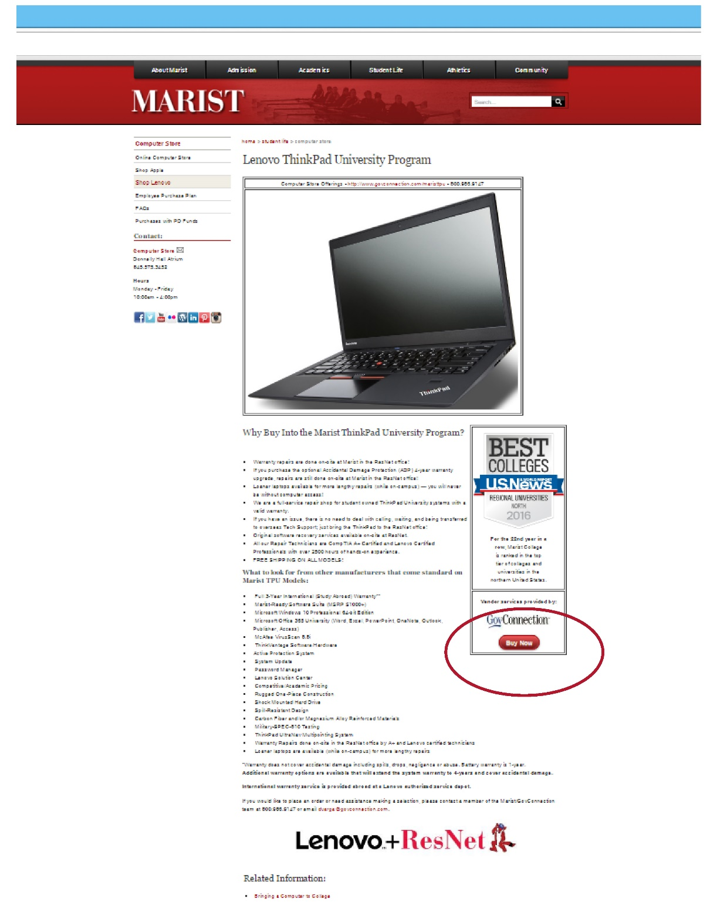
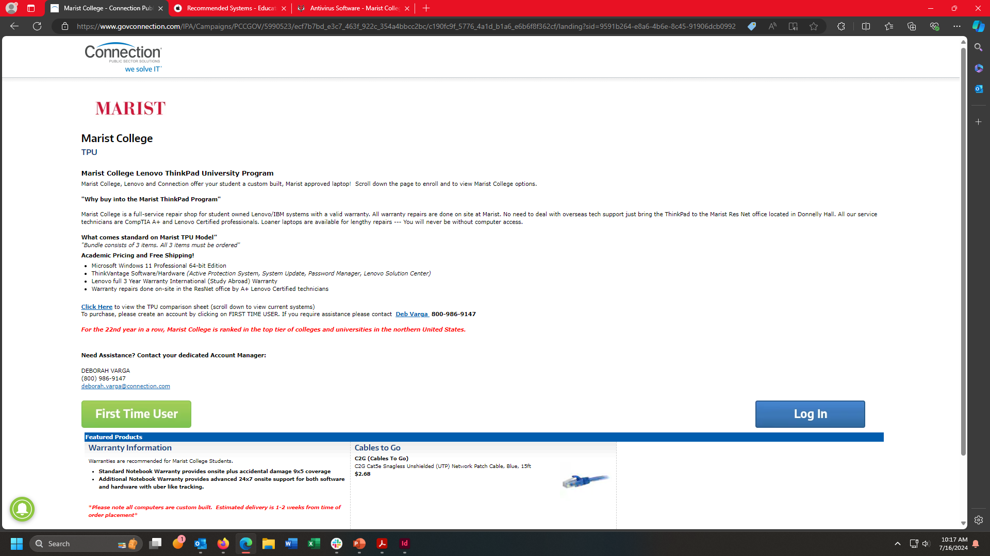
To purchase a
ThinkPad University
Lenovo laptop, select the “First Time User” button on the “Connection” page.
Notes:
This webpage hasn’t been updated since last 2017

Slide 6
Lenovo TPU program highlights:
3 years Mfg. warranty included.
The base 3-year manufacturer’s warranty only covers manufacturer’s defects and does NOT cover accidental damage including spills, drops, abuse or negligence.
Premier Bundle
  T14s and T16 cost $303
  P16s cost $287
  X1 Carbon cost $370
Premier support is Lenovo Advanced 24 x 7 x 365 Onsite support, covers both software and hardware with Uber like tracking. For more information on Lenovo Premier support go to Lenovo.com/us/en/premier-support.
All repairs done at Marist College with loaner laptop available (while on campus).
International warranty service is provided abroad at a Lenovo authorized service depot.
CrowdStrike is provided by Marist College to all current students at no charge.

Slide 7
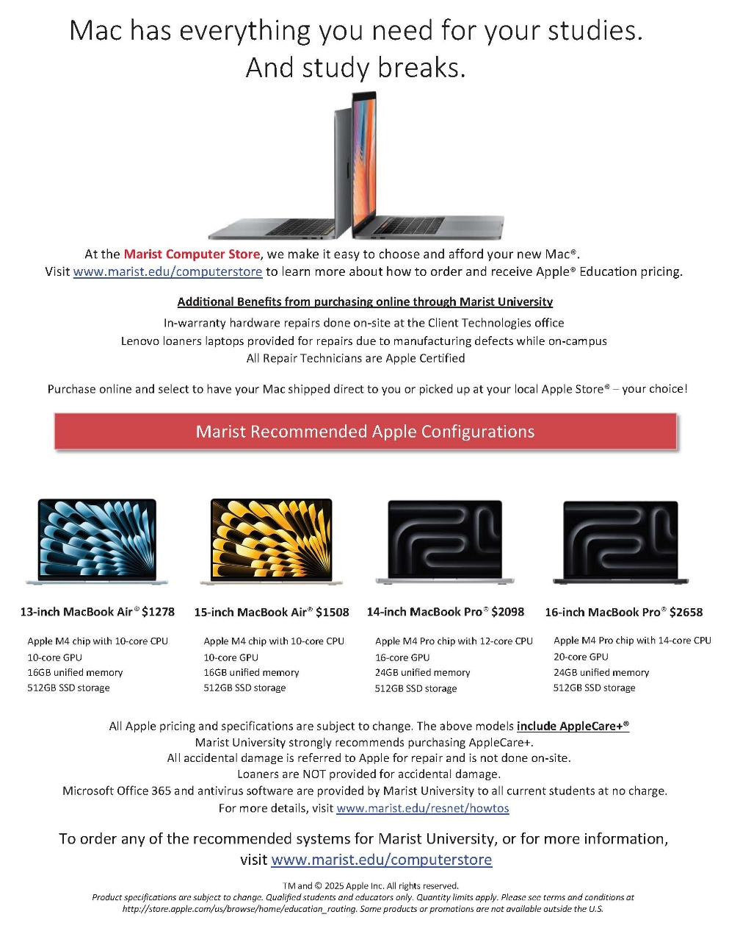

Apple laptops similar range to the recommended Lenovo TPU products
Microsoft Office is provided by Marist College to all current students at no charge.
For more details, visit www.marist.edu/resnet/howtos
Notes:
Need updated flyer from the computer store.

Slide 8
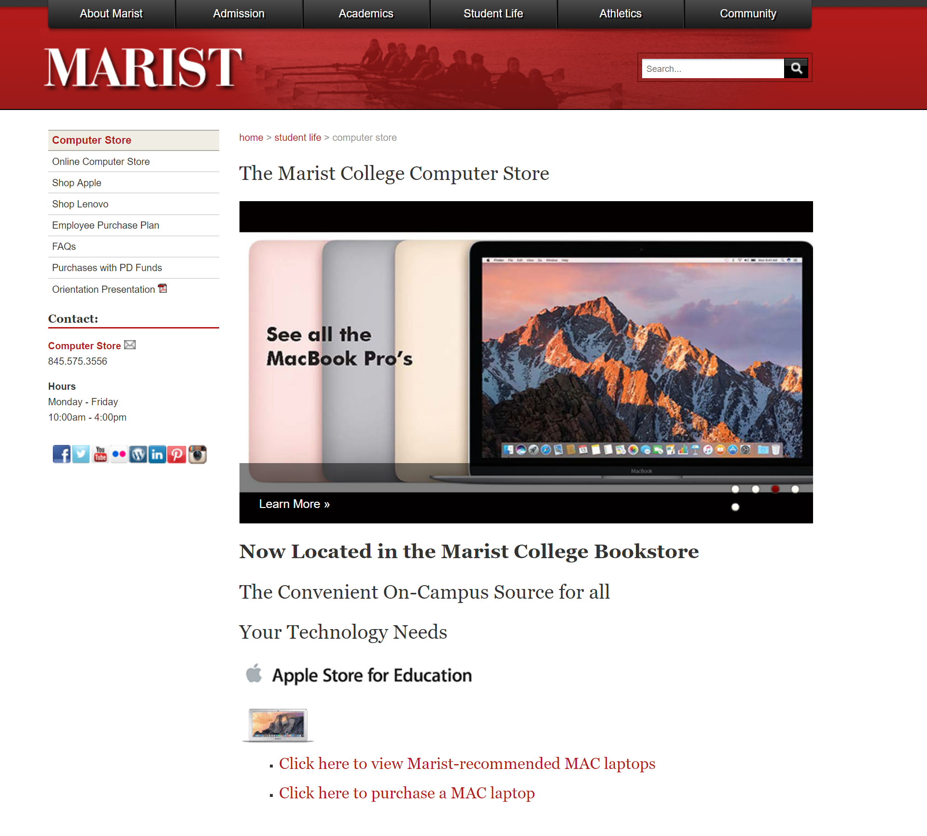
From our website, click on Shop Apple or Click Here to purchase a MAC Laptop to go to the Apple Store and see the recommended Marist options.
Notes:
Computer Store updated this page since last year so I updated the screenshot.

Slide 9
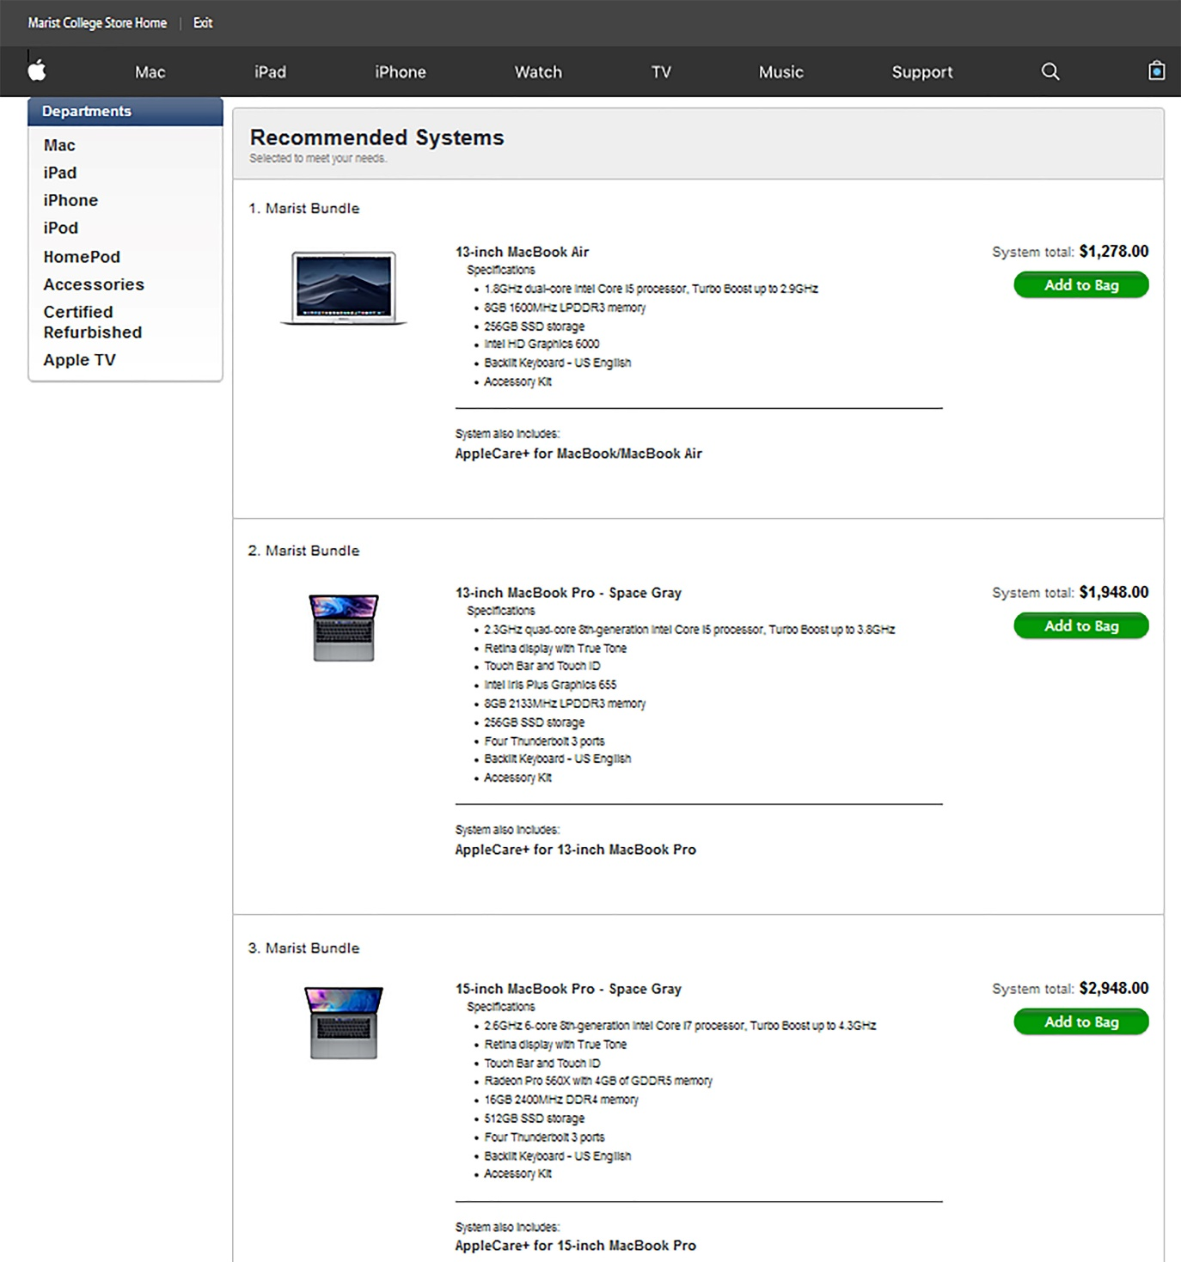
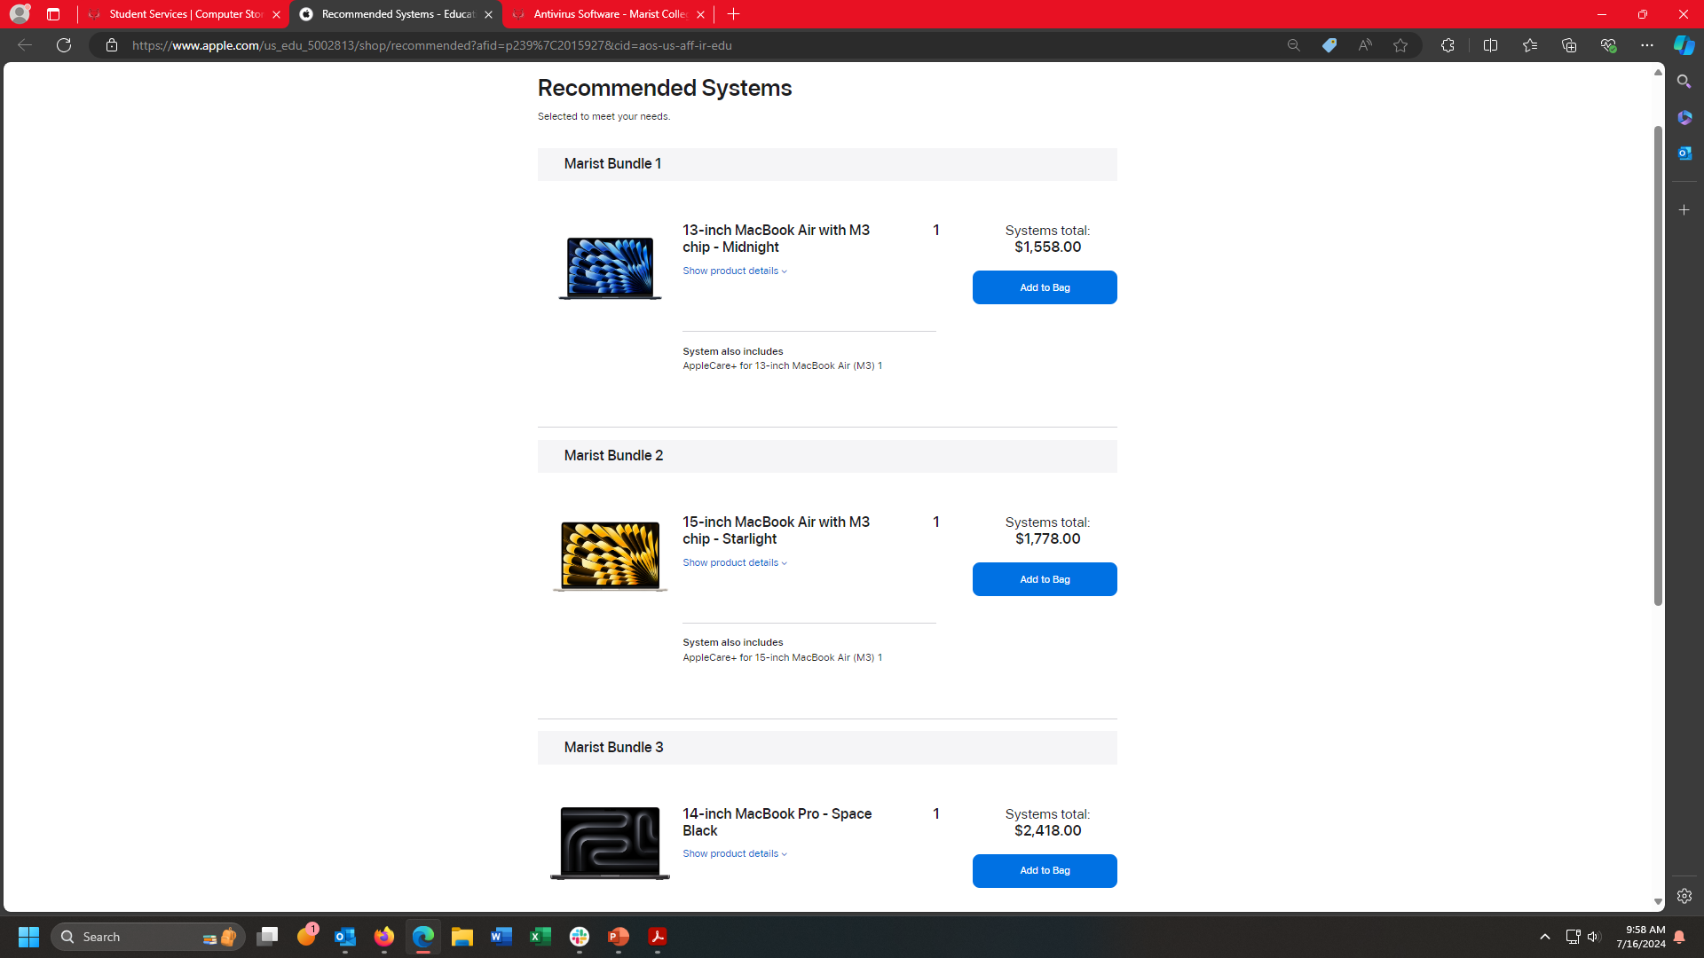
Suggested Apple laptop options.
Apple Care+ extended three-year warranty is included in price.
Notes:
Computer Store updated this page since last year so I updated the screenshot.

Slide 10
Apple Highlights:
• Comes with base manufacture’s 1-year warranty
  When purchased with Apple Care+ the manufacturer’s warranty is extended to 3 years and adds up to two incidents of accidental damage coverage, each subject to a service fee ranging from $99 to $299.
  With Apple Care+, repairs for manufacturer issues done at Marist and a loaner laptop available (while on campus).
  Accidental damage claims must be handled with Apple directly.
  No loaners laptops available while studying Abroad.

Slide 11
CONTACT INFORMATION
Phone: Tiffany Macdonald 845-575-3556
E-mail: tiffany.macdonald@Marist.edu or
computerstore@marist.edu
Visit www.marist.edu/computerstore
Microsoft Office 365 and CrowdStrike Falcon security software are provided by
Marist College to all current students at no charge.
11

