Slide 1
Marist University Computer Store -Online
Tiffany Macdonald
Coordinator
845-575-3556
www.Marist.edu/computerstore

Slide 2
Marist University Computer Store -Online
The Computer Store has moved to the cloud!
All purchases must be made on-line - www.marist.edu/computerstore.
When you are ready to buy a new laptop for your student, we strongly encourage you to purchase one of the recommended models featured on the Computer Store’s website.
Other technology related items can be purchased at the Bookstore or other retail locations.

Slide 3
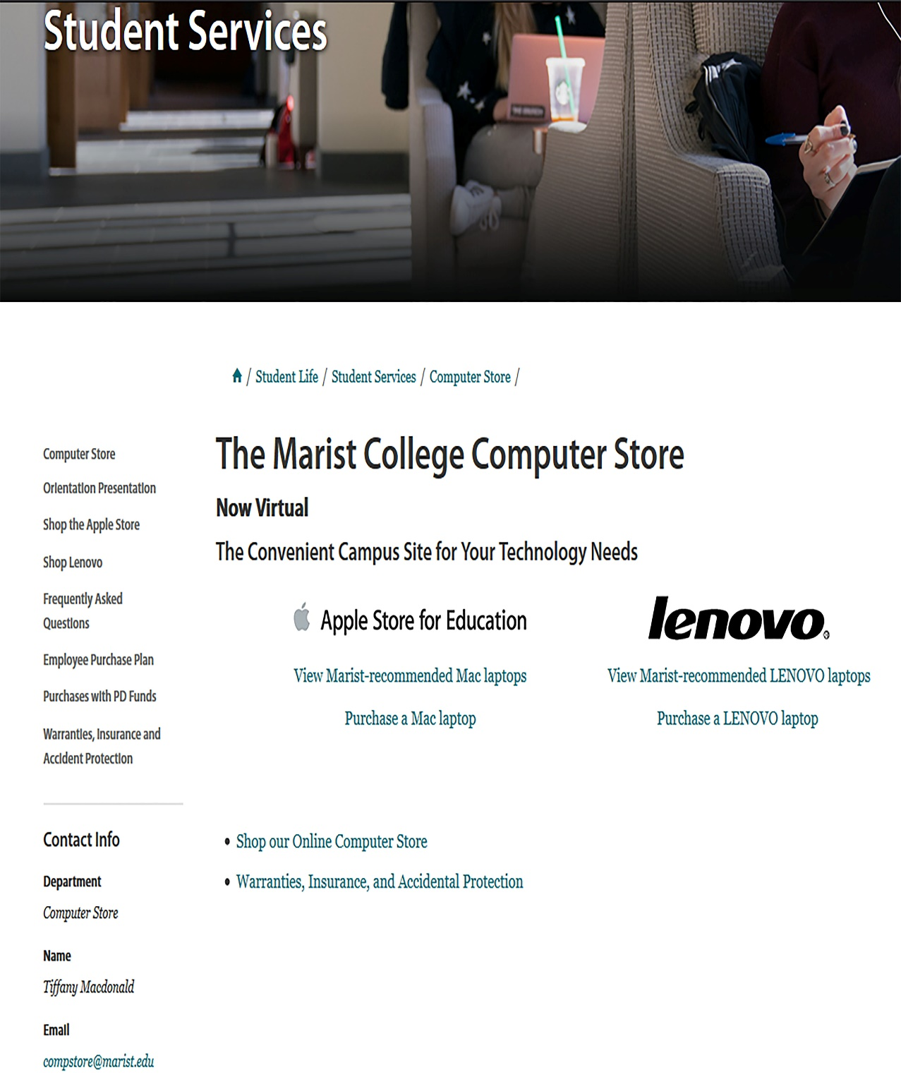
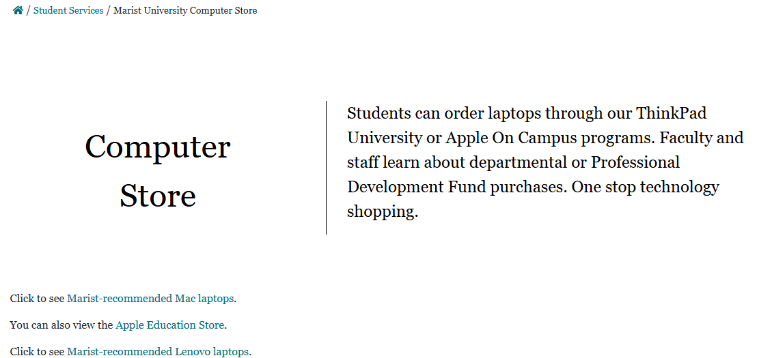
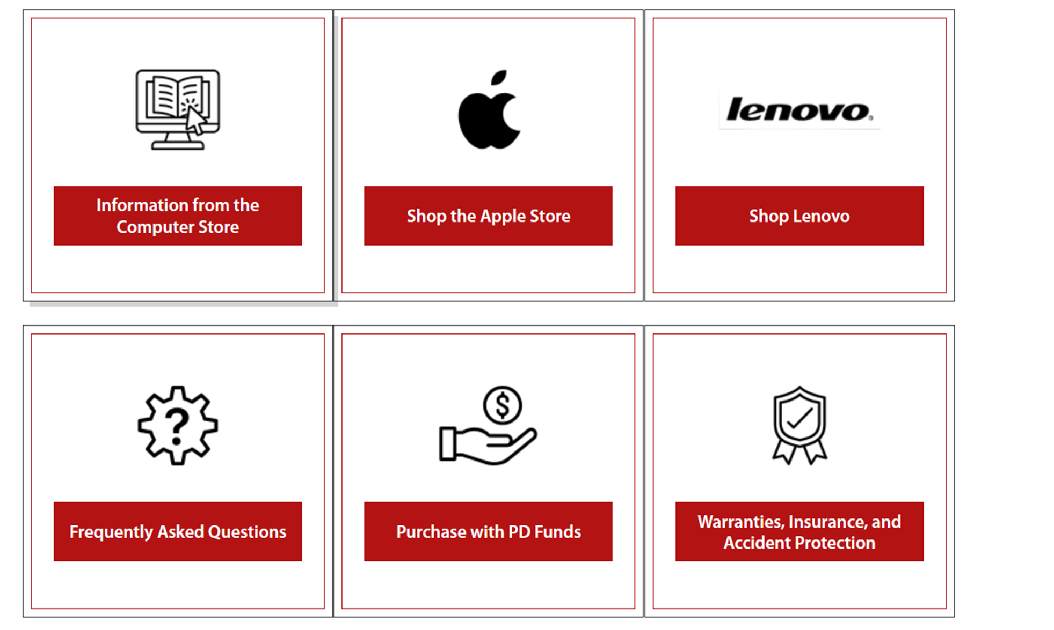
www.Marist.edu/computerstore
How to Shop @
Computer Store -Online
Laptops (purchased online only)

Slide 4
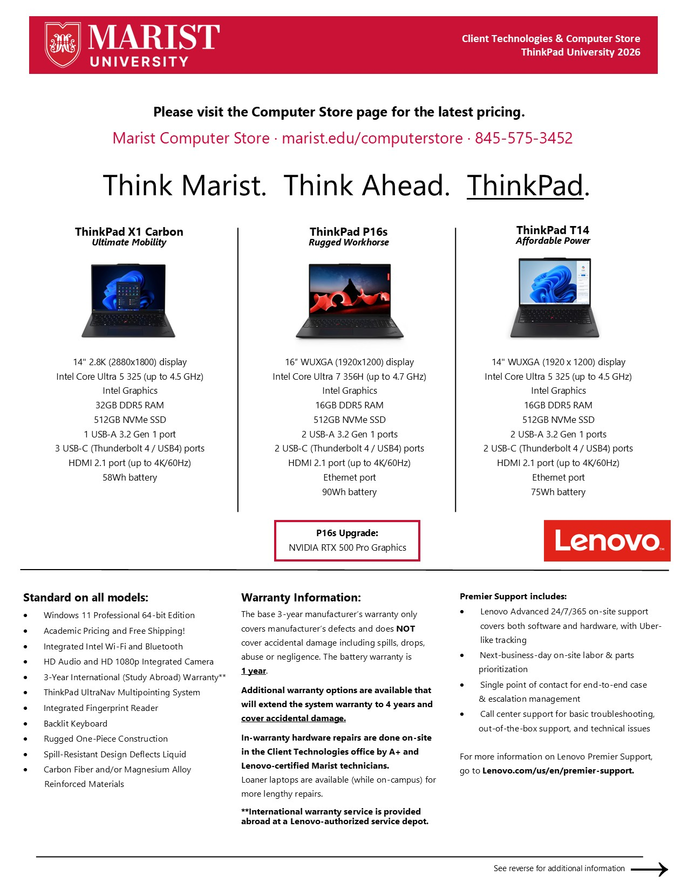
Recommended
ThinkPad University
Lenovo laptops with details

Slide 5
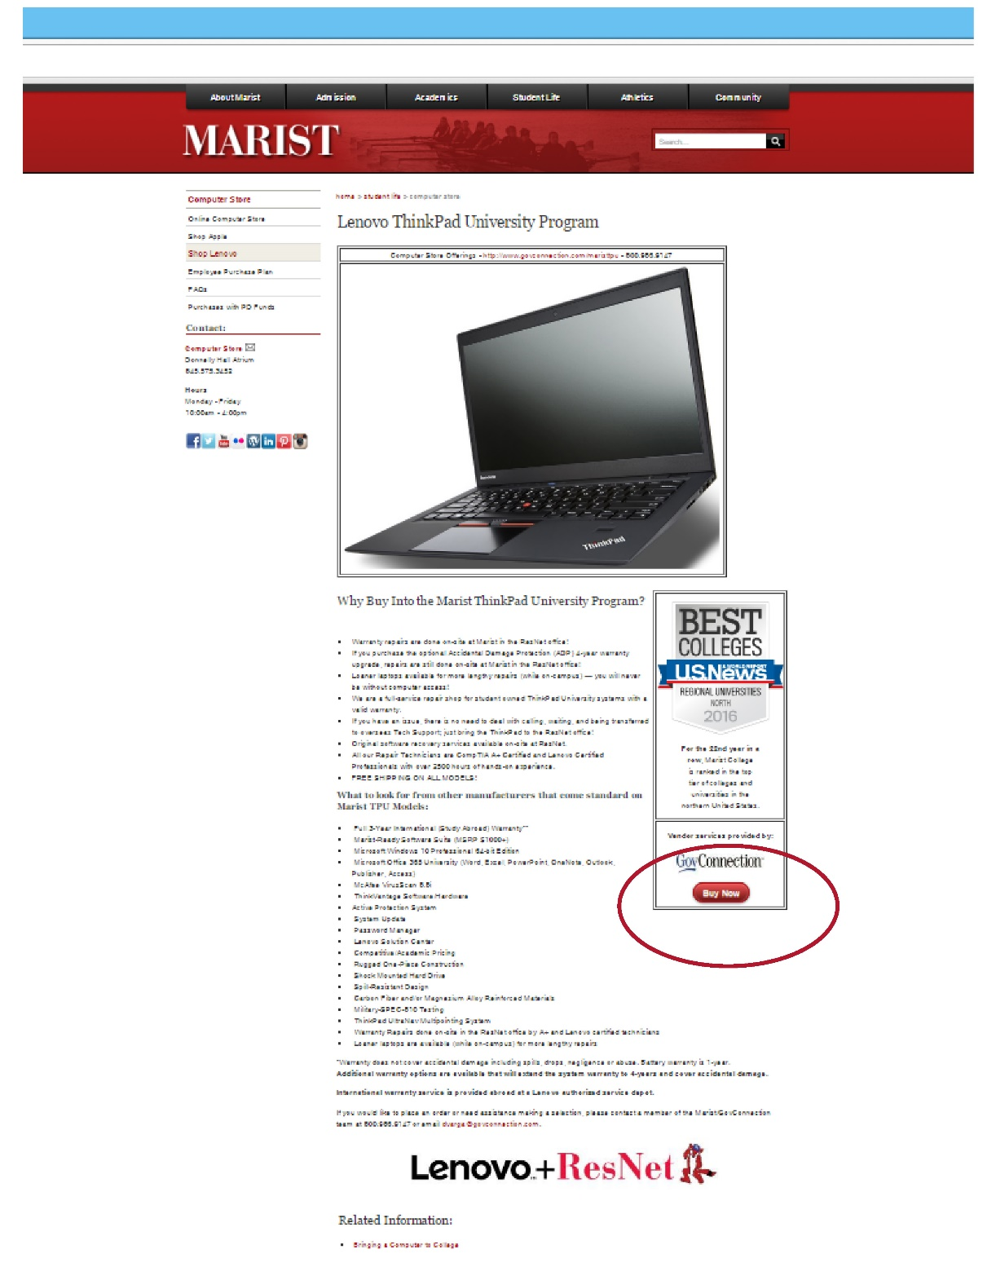
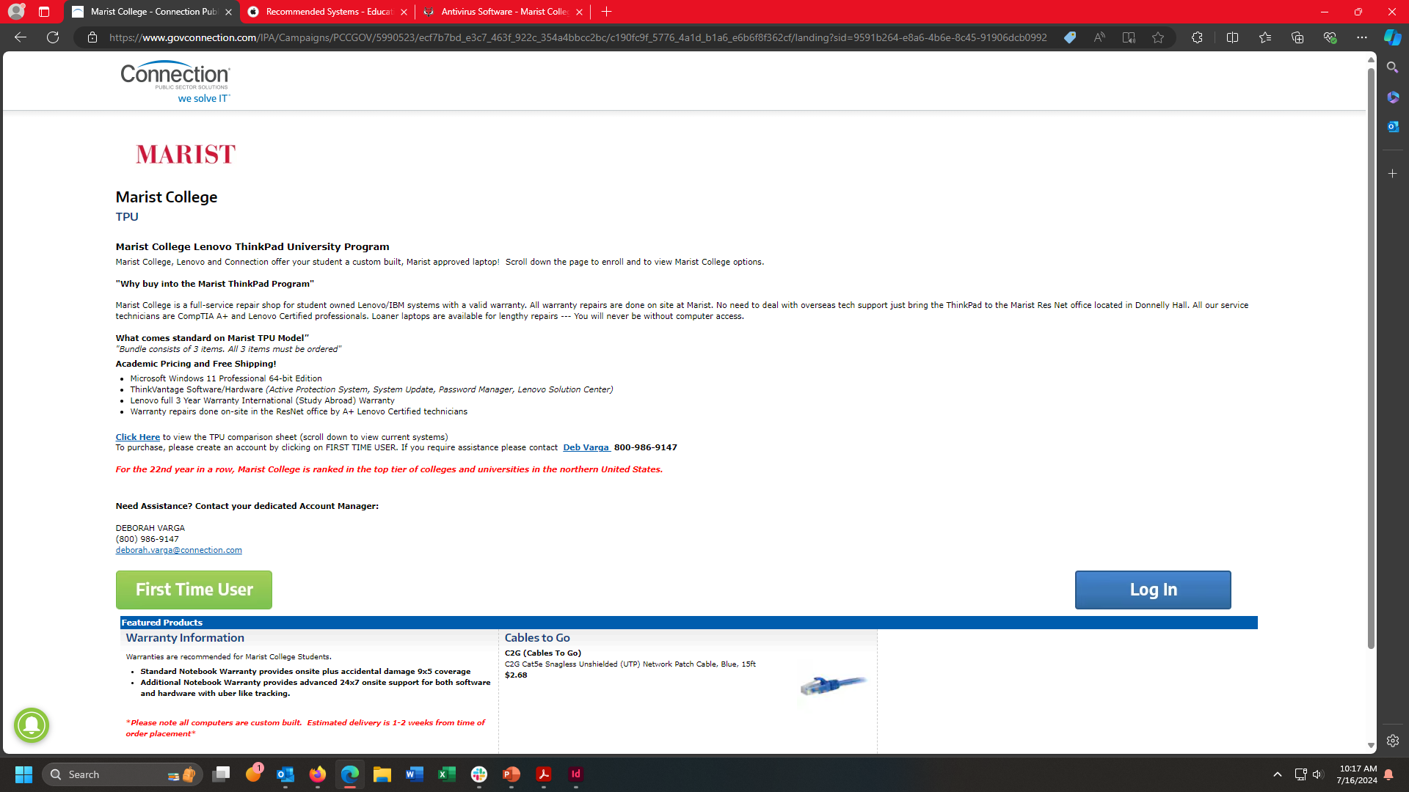
To purchase a
ThinkPad University
Lenovo laptop, select the “First Time User” button on the “Connection” page.
Notes:
This webpage hasn’t been updated since last 2017

Slide 6
Lenovo TPU program highlights:
3 years Mfg. warranty included.
The base 3-year manufacturer’s warranty only covers manufacturer’s defects and does NOT cover accidental damage including spills, drops, abuse or negligence.
Premier Bundle (Prices are subject to change)
  T14s and T16 cost $377
  P16s cost $377
  X1 Carbon cost $454
Premier support is Lenovo Advanced 24 x 7 x 365 Onsite support, covers both software and hardware with Uber like tracking. For more information on Lenovo Premier support go to Lenovo.com/us/en/premier-support.
All repairs done at Marist University with loaner laptop available (while on campus).
International warranty service is provided abroad at a Lenovo authorized service depot.
CrowdStrike is provided by Marist University to all current students at no charge.

Slide 7
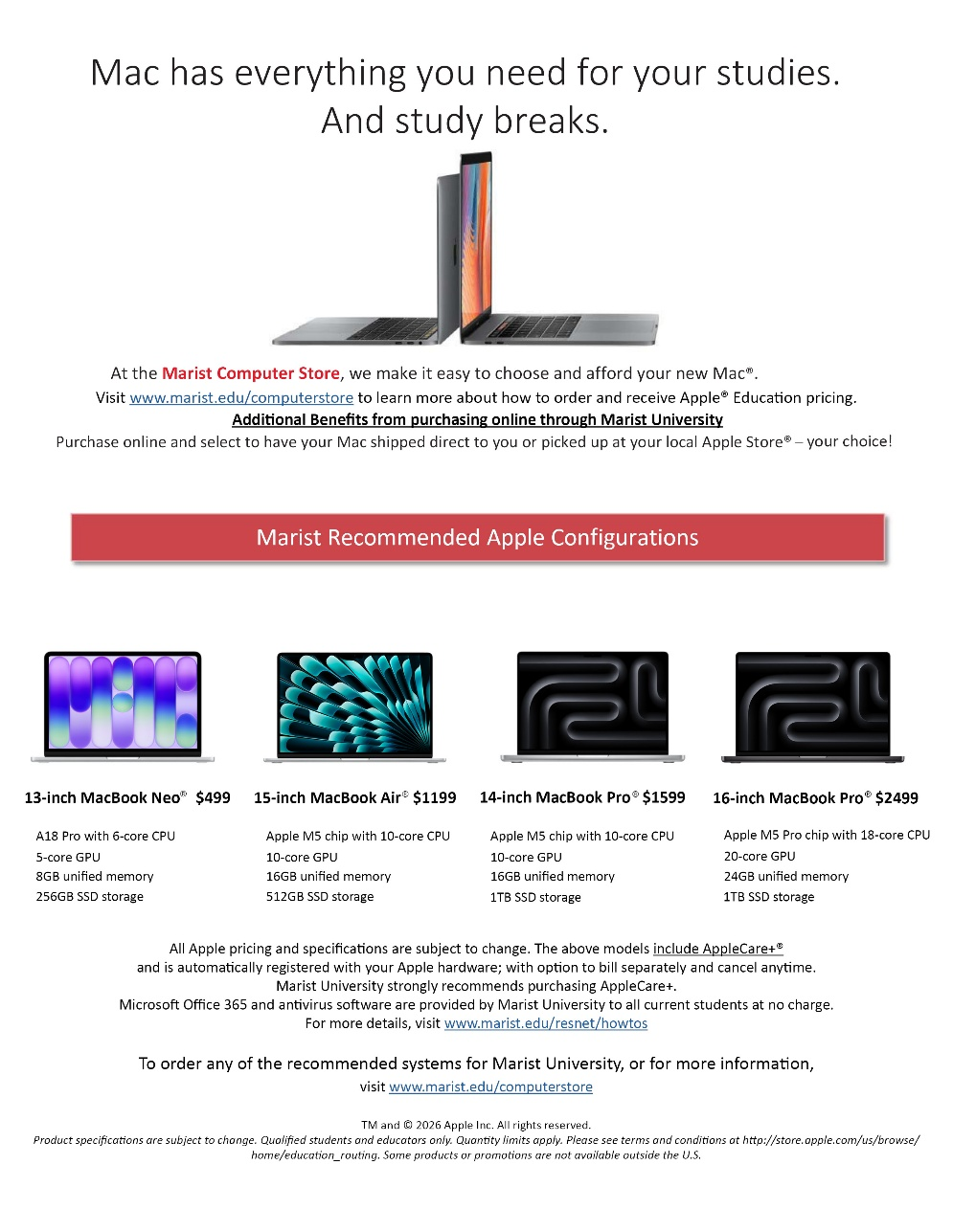

Apple laptops similar range to the recommended Lenovo TPU products
Microsoft Office is provided by Marist University to all current students at no charge.
For more details, visit www.marist.edu/resnet/howtos
Prices are subject to change
Notes:
Need updated flyer from the computer store.

Slide 8
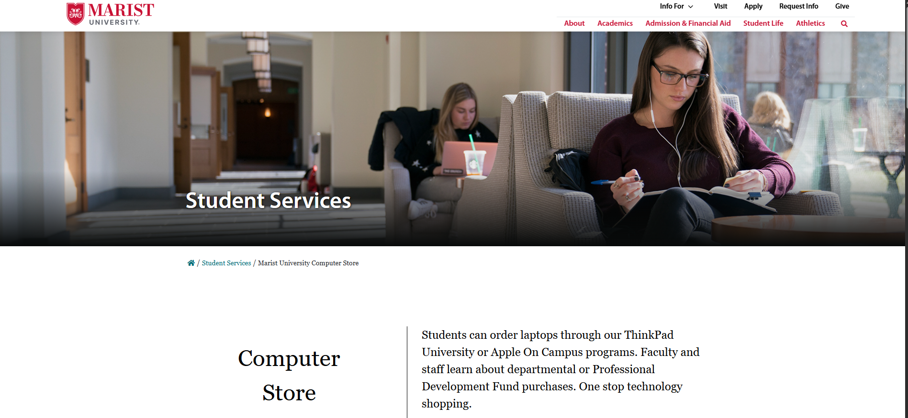
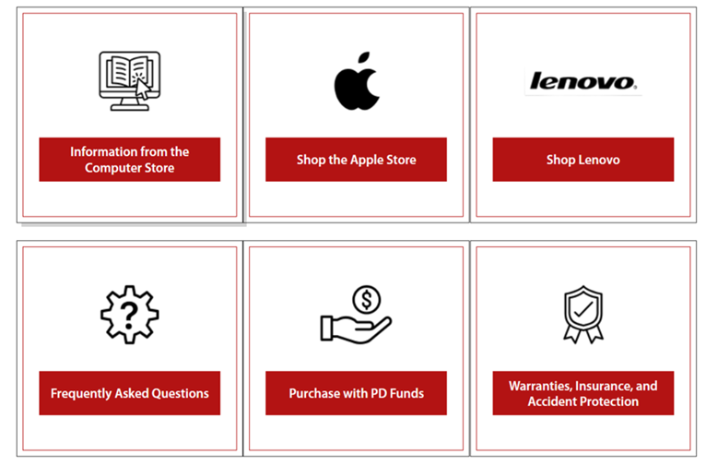
From our website, click on “Information from the Computer Store” to see the recommended Marist options.
Click on “Shop the Apple Store” to purchase a MAC Laptop from the Apple Store.
Notes:
Computer Store updated this page since last year so I updated the screenshot.

Slide 9
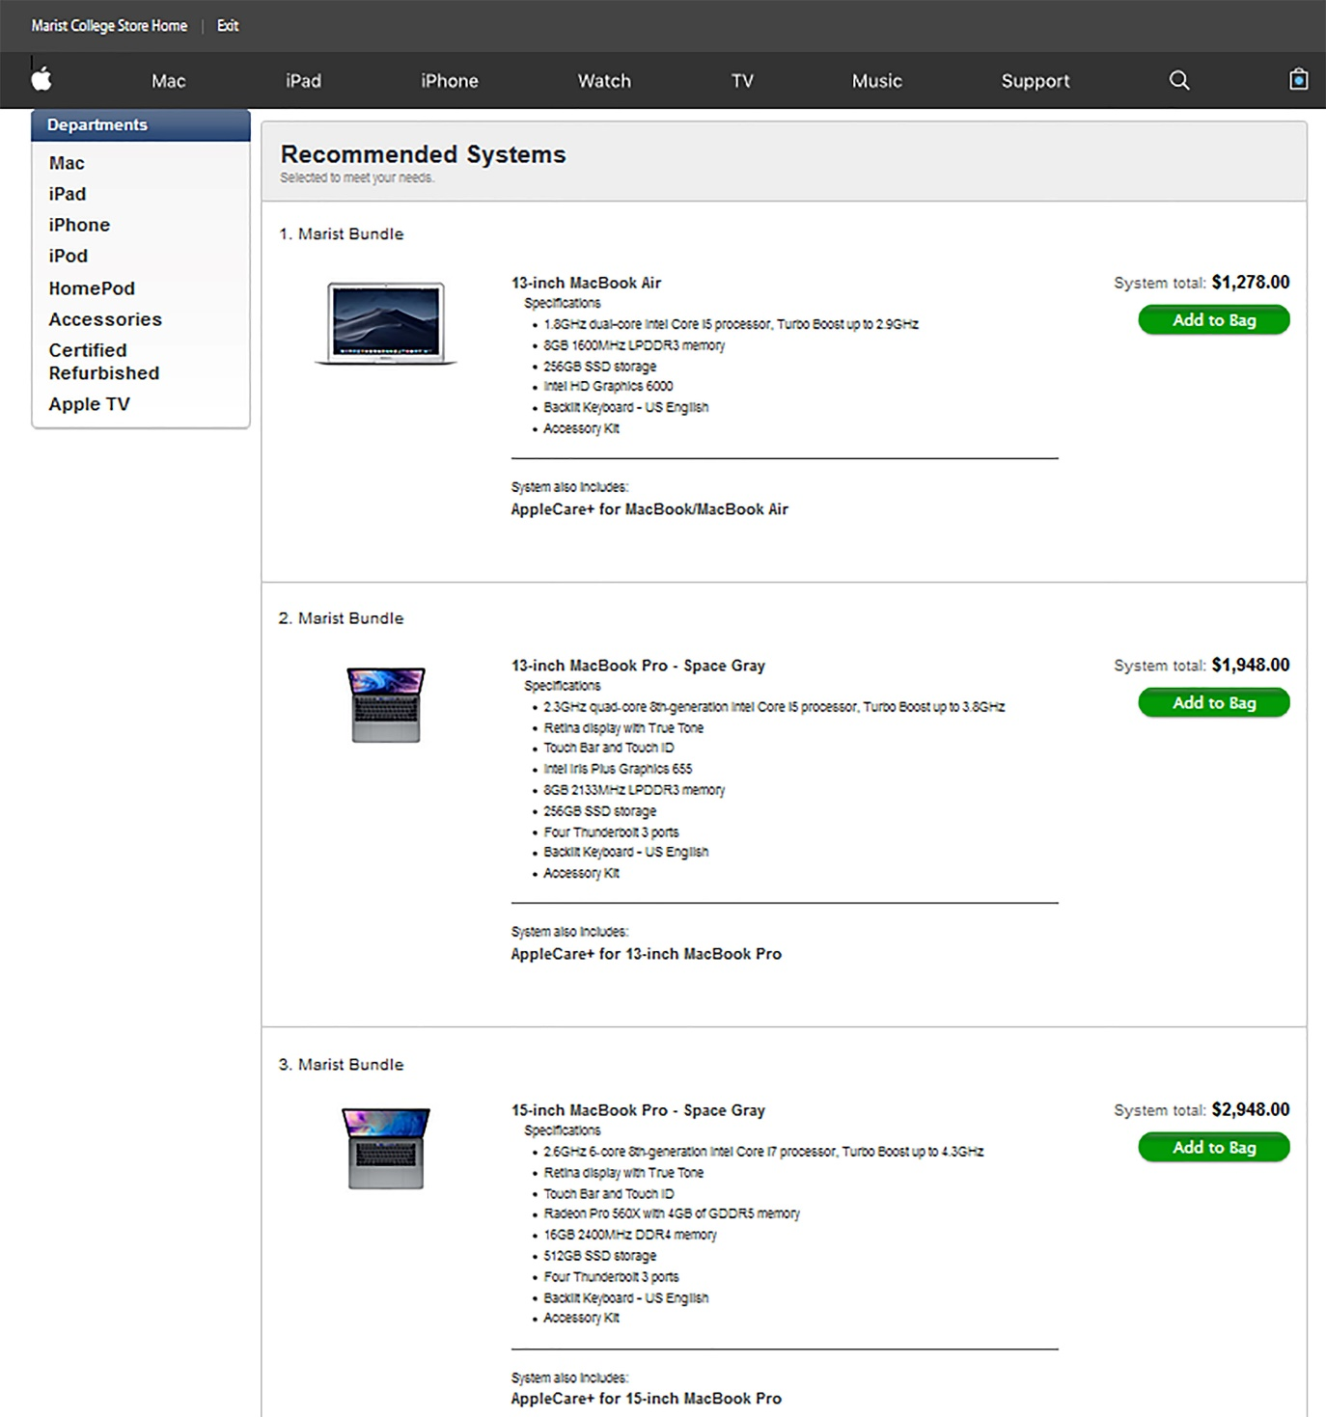
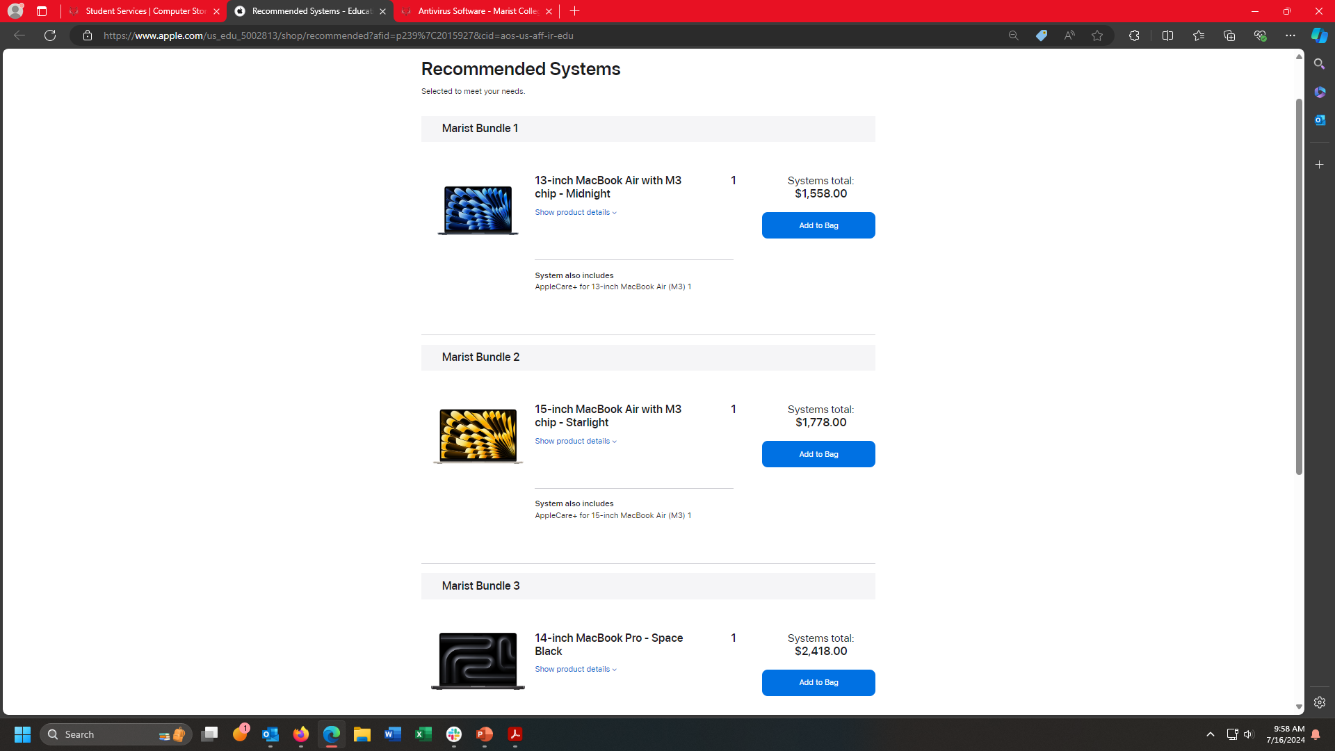
Suggested Apple laptop options.
Apple Care+ extended three-year warranty is included in price.
Prices are subject to change.
Notes:
Computer Store updated this page since last year so I updated the screenshot.

Slide 10
Apple Highlights:
• Comes with base manufacture’s 1-year warranty
  When purchased with Apple Care+ the manufacturer’s warranty is extended to 3 years and adds up to two incidents of accidental damage coverage, each subject to a service fee ranging from $99 to $299. (Prices are subject to change.)
  Marist does NOT cover or perform any repairs with Apple Care+.
  Accidental damage claims must be handled with Apple directly.
  No loaners laptops are available while being repaired with an Apple
  vendor or studying Abroad.

Slide 11
CONTACT INFORMATION
Phone: Tiffany Macdonald 845-575-3556
E-mail: tiffany.macdonald@Marist.edu or
computerstore@marist.edu
Visit www.marist.edu/computerstore
Microsoft Office 365 and CrowdStrike Falcon security software are provided by
Marist University to all current students at no charge.
11

