Slide 1
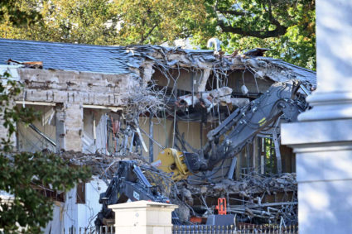
Can He Do This?

Slide 2
The Constitution
Article II: The Presidency
Section 1 Names the office (i.e., President), sets up the Electoral College and gives Congress the right to establish how Presidential elections are conducted
It also establishes the qualifications to be president: “No person except a natural born Citizen, or a Citizen of the United States, at the time of the Adoption of the Constitution, shall be eligible to the Office of President.” Future presidents also had to be at least 35 and have lived in the United States for 14 years.
In all Cases affecting Ambassadors, other public Ministers and Consuls, and those in which a State shall be Party, the supreme Court shall have original Jurisdiction. In all the other Cases before mentioned, the supreme Court shall have appellate Jurisdiction
Source: National Archive, archives.gov, reflects the spelling, grammar and capitalization of the time.
The judial Power shall extend to all Cases, in Law and Equity, arising under this Constitution, the Laws of the United States, and Treaties made, or which shall be made, under their Authority;—to all Cases affecting Ambassadors, other public Ministers and Consuls;—to all Cases of admiralty and maritime Jurisdiction;—to Controversies to which the United States shall be a Party;—to Controversies between two or more States;—

Slide 3
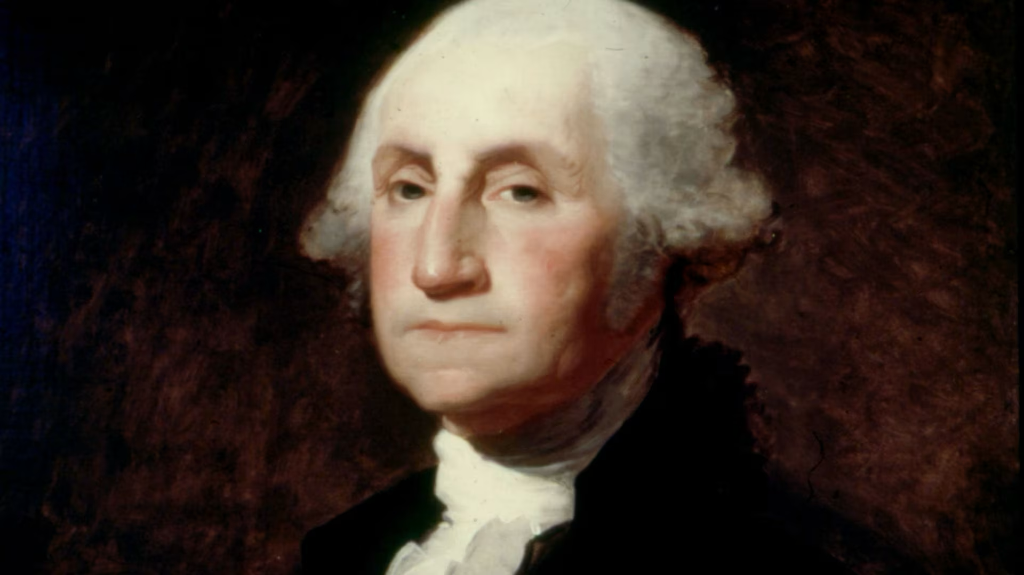
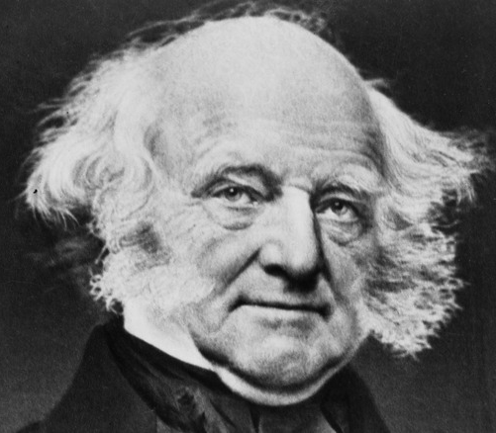
Trivia Question (Just for Fun)
Who was the first president to be born an American citizen?
Nope
Our 7th president, local boy Martin Van Buren, was born 1782 in Kinderhook.

Slide 4

Compensation
The “Emoluments Clause” (domestic)
The President shall, at stated Times, receive for his Services, a Compensation, which shall neither be increased nor diminished during the Period for
Which he shall have been elected, and he shall not receive within that
Period any other Emolument from the United States, or any of them.
Translation: The President will receive a salary which will not change
while he’s in office. He also can’t receive any other money from the federal government or individual states.
Notes:
An anti-corruption measure, designed to protect president from pressure by Congress or by a state. Also a very democratic measure – it does not force the president to be independently wealthy in order to hold office. Much discussion of the sweet spot between being enough but not so much as to tempt greedy men.
The foreign emoluments clause prohibits the president or any other govt official from accepting money from a foreign head of state or foreign govt without Congress’ consent

Slide 5
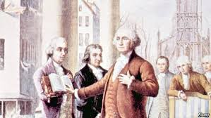
The Oath of Office
"I do solemnly swear (or affirm) that I will faithfully execute the Office of President of the United States, and will to the best of my Ability, preserve, protect and defend the Constitution of the United States."

Slide 6
The President’s Powers
Article II, Section 2
Commander-in-Chief of the Army, Navy, and “the Militia of the several states [National Guard] when called into the . . . service of the United States”
Negotiate treaties with the ”advice and consent” of the Senate
Appoint diplomatic, judicial and other government officials, also with the “advice and consent” of the Senate
Require written opinions from the heads of the “executive departments”
Grant reprieves and pardons for Federal crimes
From “time to time” inform Congress on the State of the Union along with recommendations for new laws
Convene both houses of Congress in a national emergency, as FDR’s 100 Days

Slide 7
Why So Vague?
Hint:
Washington served as president of the Constitutional Convention. Having already declined an offer to become king and quelled the Newburgh mutiny – when frustrated officers urged him to seize power by force – he had proven his commitment to republican ideals. The Founding Fathers trusted him to define the presidency; Article II was written with the statesman and leader in mind.
Notes:
with the simple act of polishing his glasses, commenting that he had “grown gray in your service and now find myself growing blind,” leaving the mutineers in tears.

Slide 8
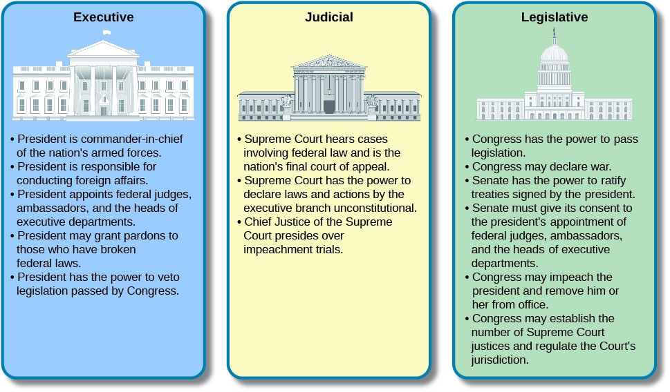
Compare 3 Branches
Article II, Section 2
of the Constitution lists 7 specific powers of the President compared to over 20 for Congress.
Constitutional scholars believe the founders wanted Congress to be pre-eminent because
it’s discussed first

Slide 9
Contradictions and Confusions
Some aspects of the relationship between Congress and the President were deliberately unclear to allow them to be worked out over time.
Examples:
“The executive Power shall be vested in a President of the United States of America” (Article II, Section 1)
Congress declares war; the President is Commander-in-Chief of the Army
Congress approves appointees, but nothing in the Constitution says it must approve when officials are fired
Congress appropriates money, but must the President spend it all?
Notes:
What does it mean to have executive power vested? How much power is that? Total power over the executive branch?
All the disputes between the branches set up in the Constitution have echoed through our history and are the source of Trump’s push to expand presidential power today

Slide 10
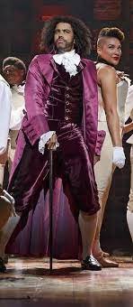
A 200-Year Tug of War
The President and Congress have vied over power since at least Thomas Jefferson’s time:
Buys Louisiana using his power to conduct foreign policy – but ignores Senate “advice and consent” on a treaty
Sends the navy after the Barbary pirates in the Mediterranean without a declaration of war; becomes the first – but certainly not the last – to expand presidential power over the army
Notes:
2 historic examples – Jefferson The Constitution says Congress declares war but the President is Commander in Chief of the Army. Jefferson allegedly believed in limited federal govt and executive power, but he probably expanded presidential power more than any president before Lincoln.

Slide 11
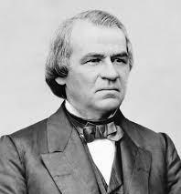
A Low Point in Presidential Power
Andrew Johnson (1865-69)
Lincoln’s Democratic Vice President, former senator from Tennessee
Abrasive, racist and alcoholic
Conflict with Congress after it achieved a veto-proof majority in 1866 elections
Impeached for disobeying Tenure of Office Act which gave Congress the power to approve firing Presidential appointees. Acquitted by one vote, weakening presidency for 60 years
Notes:
Johnson The Constitution says the Senate must ”advise and consent” to the appointment of gov’t officials – without identifying which – but says nothing about firing. Pres. Trump has been fighting the issue through the federal courts since he took office, and says he

Slide 12
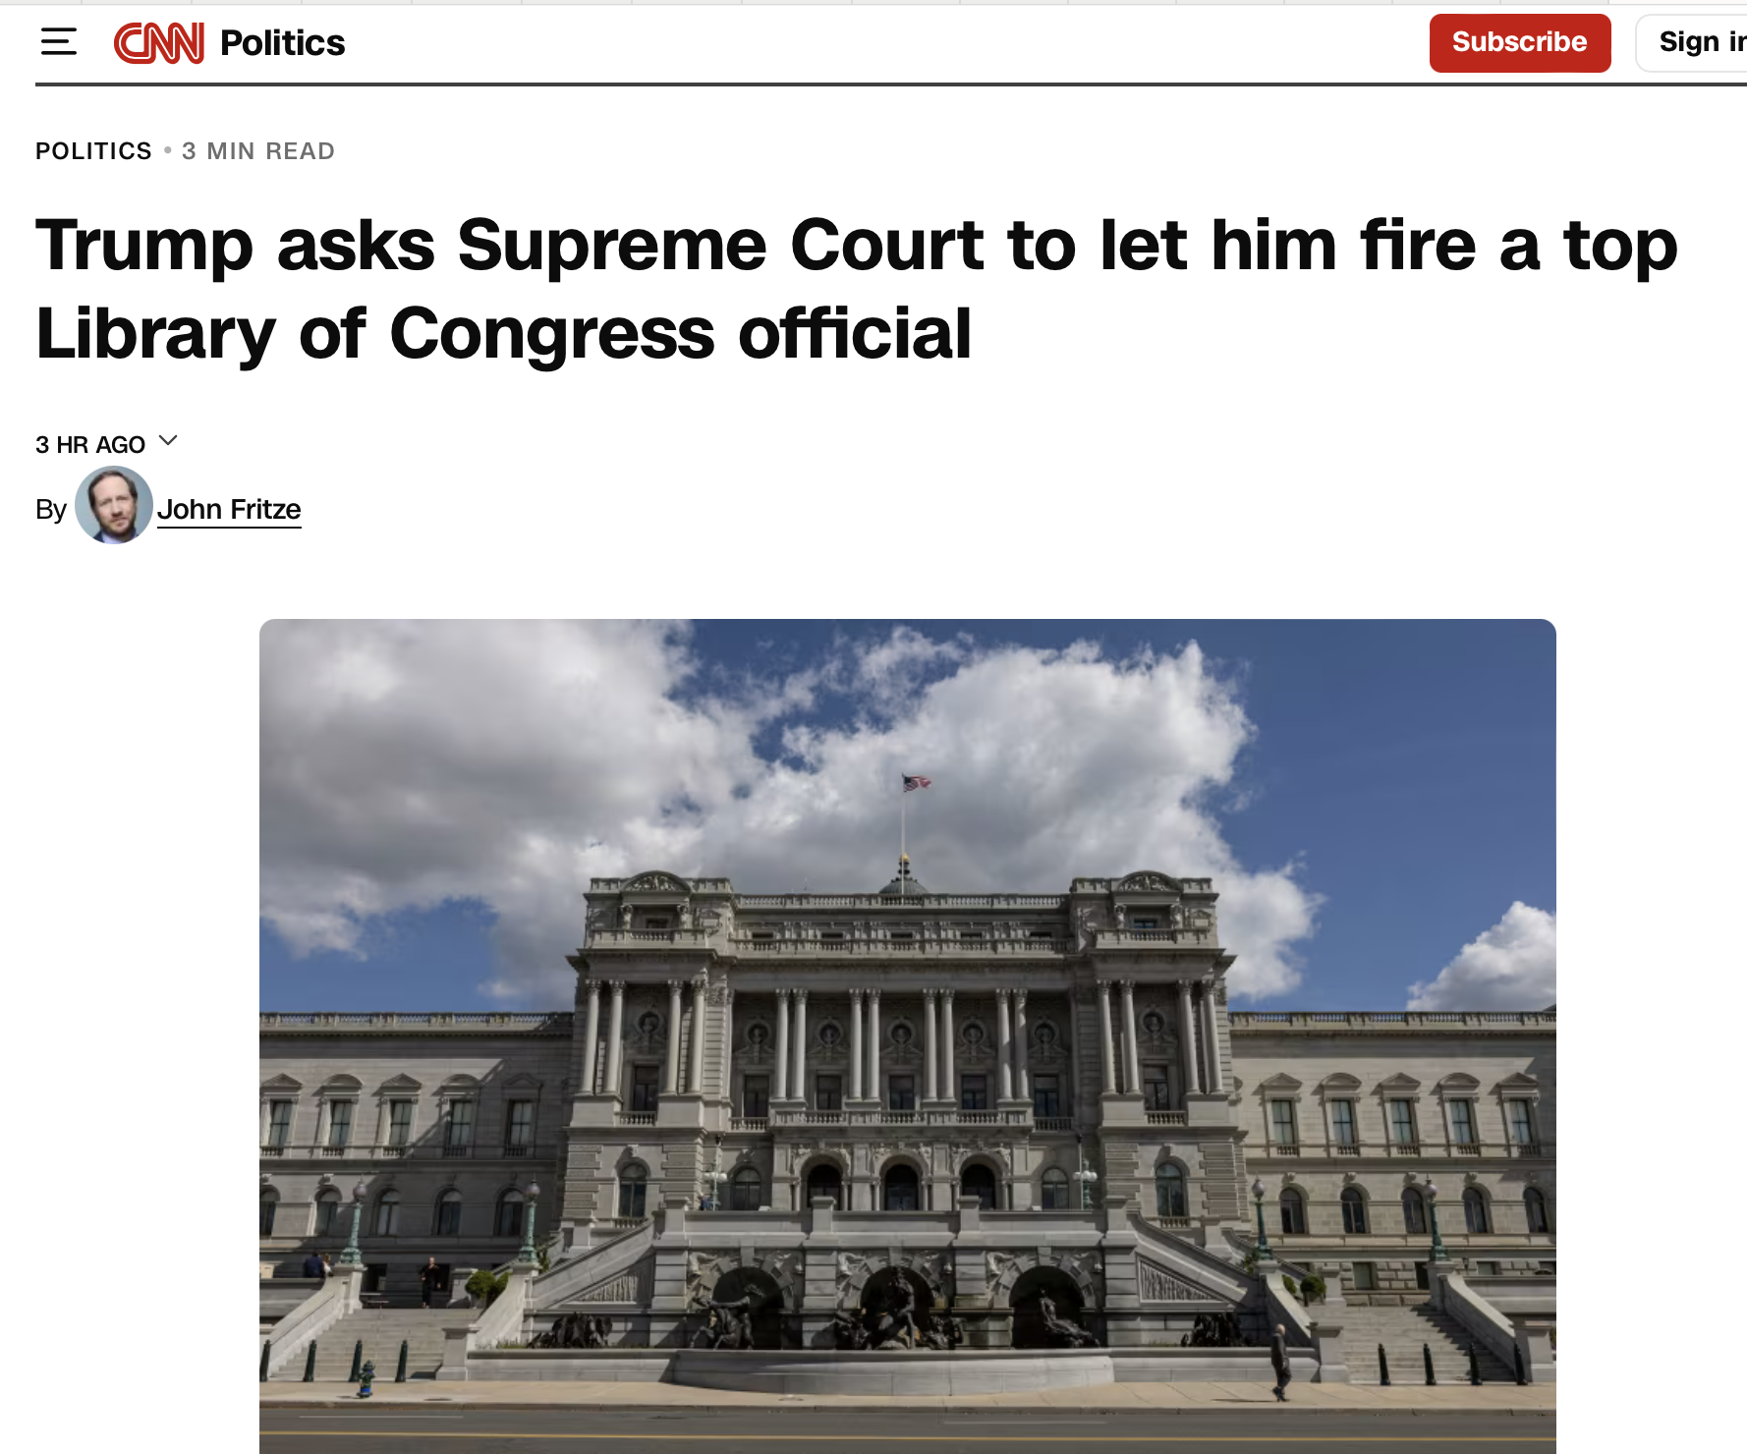
The more things change . . . 10/27/2025
“US Circuit Judge Justin Walker . . . noted that the Supreme Court has ‘recently, repeatedly, and unequivocally’ stopped courts from stepping in when Trump has fired officials.”
Notes:
Trump

Slide 13
Why Now?
The Unitary Executive Theory
The question of how much control the President had over the executive branch dates to the Constitutional Convention
President is in sole (unitary) charge of the executive branch, including composition and staffing
As part of originalism, supporters believe President’s powers should resemble the King of Great Britain’s when the Constitution was written
Rose with conservatism starting with Reagan’s election in 1980 and reaching its highest point now under Pres. Trump
Source: Legal Information Institute, Cornell Law School, law.cornell.edu

Slide 14
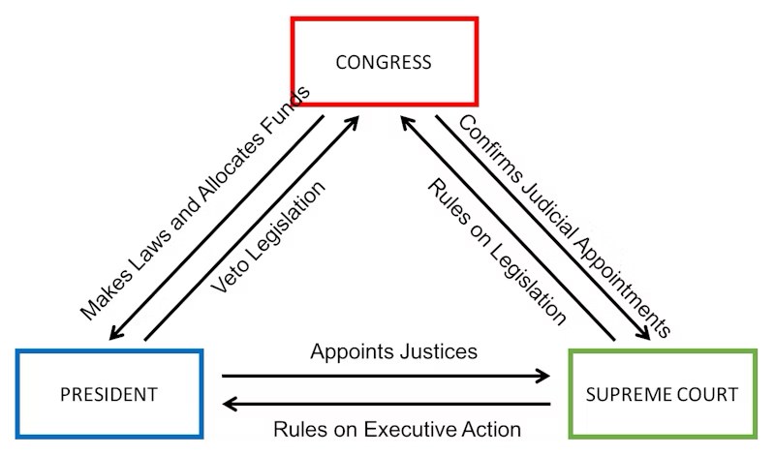
Checks and balances
3 branches of government each assigned specific tasks and also given ways to stop the other branches from getting too powerful

Slide 15
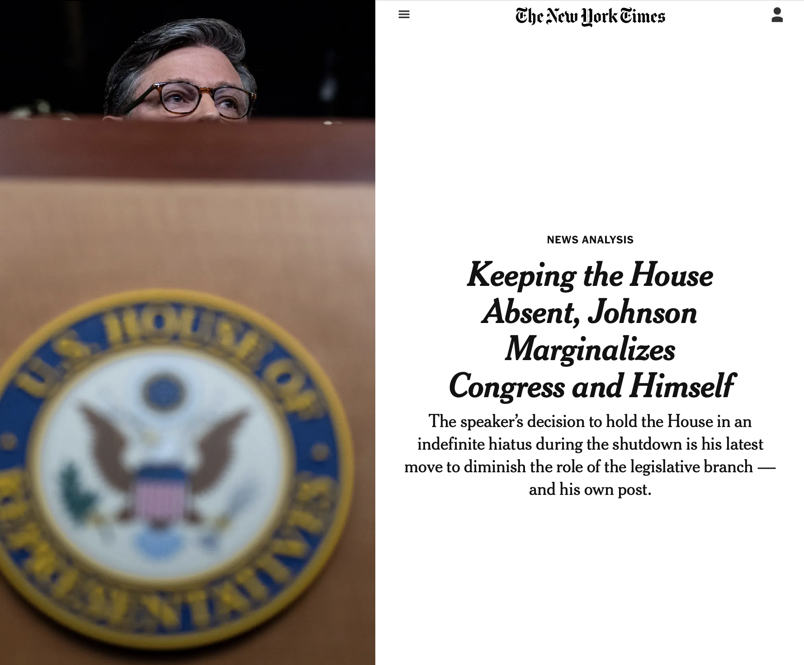
. . . Requires all 3 branches . . .
New York Times, Oct. 25, 2025

Slide 16
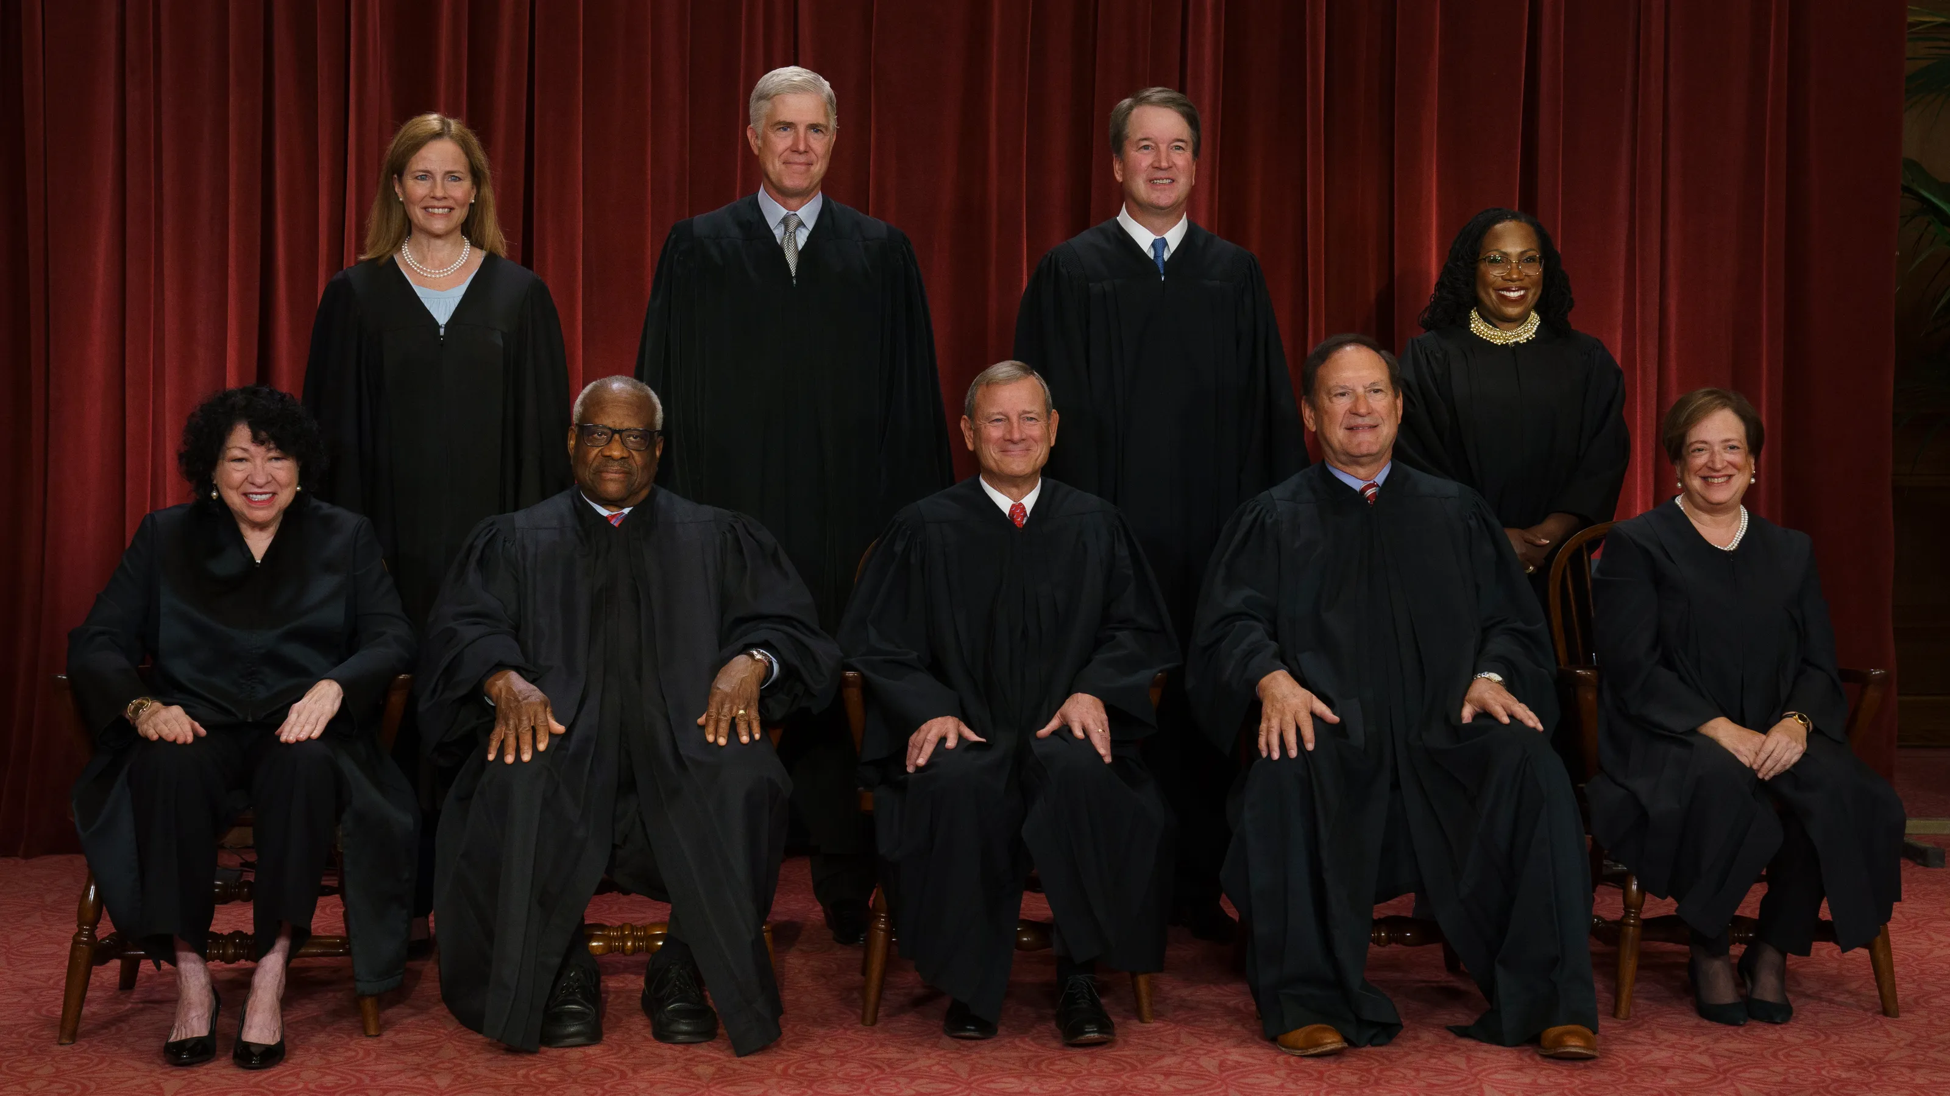
. . . To Work . . .
Originalist Supreme Court justices (from left): Amy Coney Barrett,. Clarence Thomas, Neil Gorsuch, Chief Justice John Roberts, Brett Kavanaugh and Samuel Alito.

Slide 17
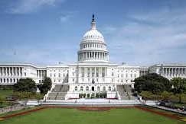
How does this relate to the shutdown?
In the absence of Congress, Pres. Trump has moved to increase his power by:
Cutting funding to the Dept. of Education that had already been allocated by Congress
Pressing his right to fire officials confirmed by the Senate
Threatening layoffs in addition to furloughs if the shutdown continues

