Slide 1




,
Hearing Panel Training
Kelli Campa – Director of Student Conduct
Kelly Yough – Director of Equity and Title IX Coordinator
Bill Meyer, TIX Investigator
Tam Cacchione, Family Services, CVSS Campus Advocate
1

Slide 2
Overview of what the Office of Student Conduct does
Review and manage reports of alleged policy violations
Determine appropriate follow-up action to incidents
Counsel students about their rights in the process
Policy review and consistent enforcement of Code
Trainings/Presentations about College policies
Oversee Academic Integrity process
Ensure sanction compliance
Background checks
Notes:
I read every report that comes in and determine the violation if any that occur.
I assign the case back to the appropriate RD to hear (conduct conference)
Each summer we review the code of student conduct and determine any changes
Train RDs, RAs, students about our policies
Academic integrity: those that get caught plagarizing/cheating
All educational sanctions need to be completed otherwise the student could come back to our office for failure to comply or a hold
Background checks: police, study abroad, grad school
Radar: group that helps address concerns about students (may be an FYI report)

Slide 3
General Steps Following a Student Conduct Incident
Incident Occurs
Incident Report Submitted
Report Reviewed by Student Conduct Director for Appropriate Action
Notice of Allegation Letter Sent
Student Accepts Resolution: Notice of Finding/Sanctions Sent
Student Disagrees w/ Resolution: 1. Case referred to Director (if RD was original officer), decision of Director is final; or 2. Hearing Panel (if Director was original officer); if applicable
Conduct Conference Occurs with RD or Director (student accepts or disagrees with resolution); if applicable
Complete Sanctions
Notes:
Explain process from start to finish
After you respond to an incident and write a report it is automatically received in the Student Conduct
We read your reports, as well as any other reports from the incident (OCA report, PS report, written statement, photos)
We decide if potential charges exist for violating the Code of Conduct – We apply the appropriate charges, decide upon the level of hearing (Explain the hearing levels and what are the factors that determine that) – if an RD will hear the case or myself
Notify student
Hearing occurs - 3 business days
Notice sent within 10 business days of decision (Standard of Evidence used)
Complete sanctions (What goes into this decision) POSSIBLE SANCTIONS (HOSTING A PARTY WITH ALCOHOL – probation, loss of 2 priority points, and an educational sanction)

Slide 4
Types of Hearing Panels
Academic Integrity Hearing Panel
Appeals Hearing Panel
College Hearing Panel
Title IX Hearing Panel
Notes:
All hearing panels are audio recorded.
Will try and meet in person this year.

Slide 5
Academic Integrity Hearing Panel
Typically Instructor meets with student first
Director of Student Conduct serves as advisor to board
Follow a script
Panel consists of at least 2 faculty (3 board members total)
Can ask questions to:
Responding Party (student)
Instructor of course
Witnesses (if applicable)
Determine responsibility and sanctions
Notes:
Kelli
Instructor will meet with student to try to come to an agreement. If student does not agree to responsibility or sanctions then they can request a hearing board.

Slide 6
Appeals Hearing Panel
Panel consists of 3 members typically
Panel consists of at least 2 faculty (3 board members total)
Appeal requests are limited to:
Irregularities in fairness
Will only hear cases below suspension/expulsion
Discovery of new information
Sanctions imposed are outside parameters of typical offense
Review case and determine:
Affirm finding and sanction
Affirm finding and modify sanction
Reopen for new hearing
Dismiss case
Notes:
Irregularities in fairness and stated procedures of the hearing that could have significantly impacted the outcome of the hearing. 2. Discovery of new and significant information that could have affected the outcome of the original hearing or investigation. The information was not known or could not reasonable have been discovered and/or presented at the time of the initial hearing and could substantially impact the original finding or sanction. Failure to provide information during or participate in an investigation or a hearing, even resulting from concern over pending criminal or civil proceedings, does not make evidence “unavailable” at the time of the hearing. A summary of this new evidence and its potential impact must be included, 3. The sanctions imposed are substantially outside the parameters or guidelines set by the College for this type of offense or the cumulative conduct record of the responding party. I will review and determine if an appeal hearing board will happen.
VP of Student Affairs is appeal offer for suspension/expulsion cases. Review case means review written and recording. Witnesses may be called if necessary.
Affirm the finding and sanction originally determined. 2. Affirm the finding and modify the sanction. In cases where the responding party is the appealing party, the sanction may be reduced or increased by the conduct body reviewing the appeal. 3. Reopen the investigation and/or remand the case to the original conduct body for a new hearing, except in cases where the reporting party is the appealing party. 4. Dismiss the case, except in cases where the reporting party is the appealing party

Slide 7
College Hearing Panel
Director of Student Conduct serves as advisor to panel
Follow a script
Panel consists of 3 members typically
Opportunity to ask questions to all parties and witnesses
Determine responsibility and sanctions
Notes:
Kelli

Slide 8
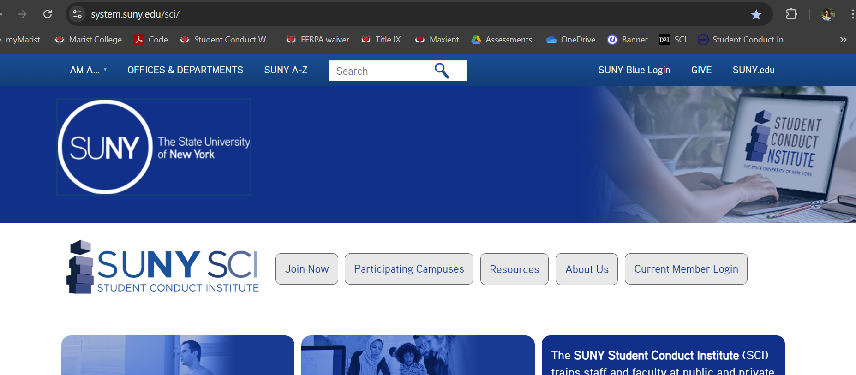
SCI Training

Slide 9
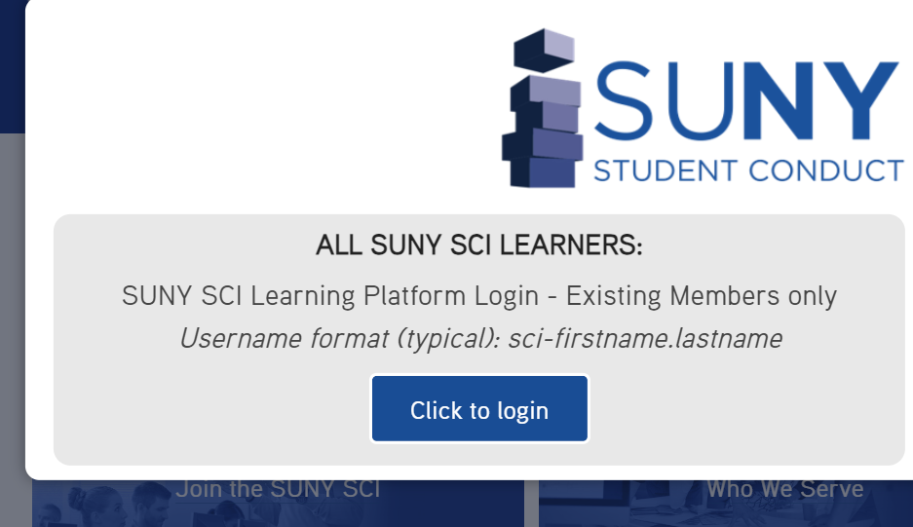
SCI Training

Slide 10
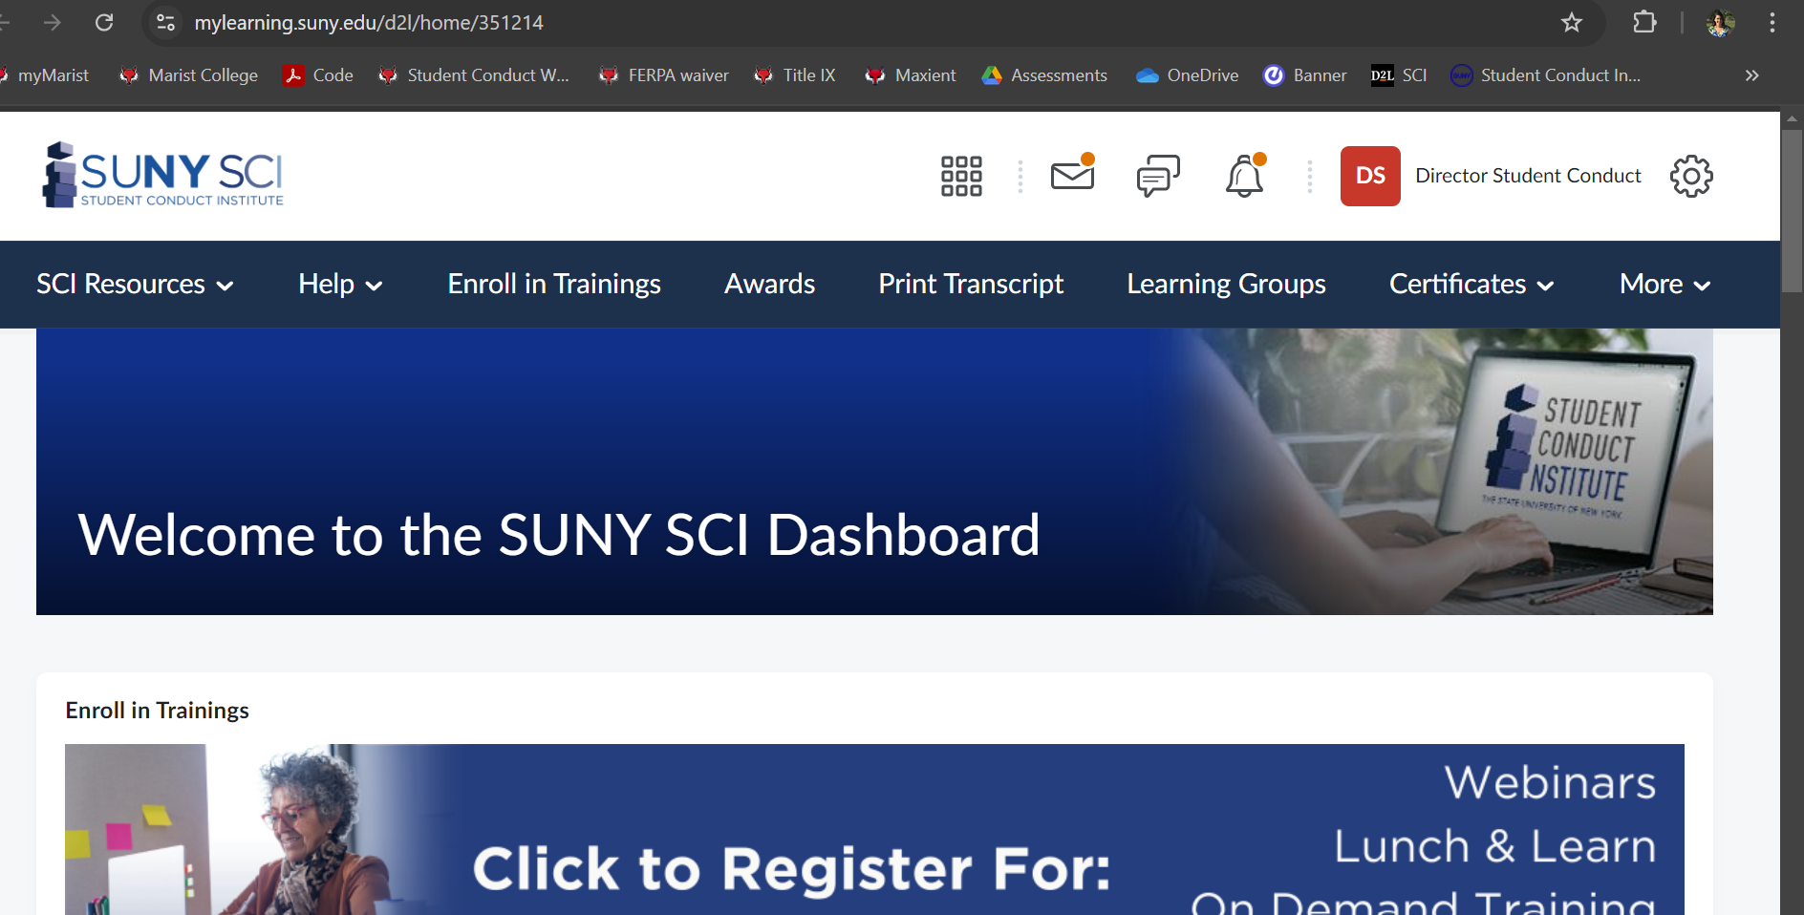
SCI Training

Slide 11
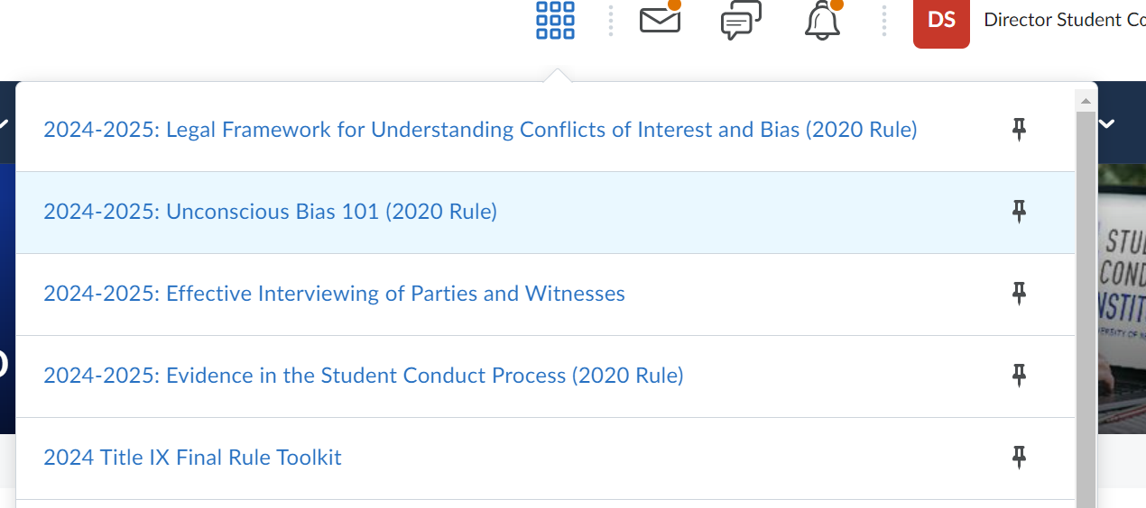
SCI Training

Slide 12

“ No person in the United States shall, on the basis of sex, be excluded from participation in, be denied the benefits of, or be subjected to discrimination under any education program or activity receiving federal financial assistance.”
Title IX of the Education Amendments of 1972 Implementing Regulations at: 20 U.S.C. § 1681 & 34 C.F.R. Part 106

Slide 13
Major Differences: 2020 vs 2024 TIX
1. Scope – expands definition of Sex Discrimination.
2. Location – expanded (same as Student Conduct)
3. Formal Complaint – no signature
4. Definition of Sexual Harassment -severe or pervasive and objectively offensive
5. Sexual Harassment - sex-based harassment
6. Five ways to assess hostile environment

Slide 14
Major Differences: 2020 vs 2024 TIX
7. Cross-examination - not by advisors
8. Time frames - shortened and no draft report period
9. Informal Resolutions – any time - not just after a complaint filed
10. Supportive Measures – now opportunity to appeal/ emergency removals for physical threats, too.
11. Definition of Complainant (in sex discrimination allegations only) to at the time the discrimination occurred.
Allegations reported to have occurred before August 1, 2024, will follow 2020 policy and procedures.

Slide 15
What has not changed:
1. Affirmative Consent
2. Due Process/Fairness
3. Amnesty Policy
4. Disclosures: All employees with exception to confidential must report disclosers of sexual misconduct to TIX.
5. Advisor of Choice
6. Preponderance of Evidence
7. Complainant has agency on how to proceed.
8. Investigative report format

Slide 16
Scope of Title IX - 2024 Rule
            Expanded to include:
            Sex stereotypes, sex characteristics, pregnancy or related conditions, sexual orientation, and gender identity.

Slide 17
Sex-Based Harassment: 2024
Title IX regulations continue to use the umbrella term to define acts of sexual misconduct and violence.
1. Quid Pro Quo
2. Sexual Harassment - Severe or Pervasive and Objectively Offensive.
3. Clery Act Crimes a. Sexual Offenses, forcible and non-forcible b. Domestic Violence c. Dating Violence d. Stalking

Slide 18
Quid Pro Quo Harassment
“An employee, agent, or other person authorized by the institution to provide aid, benefit, or service under the institution’s education program or activity explicitly or impliedly conditioning the provision of such aid, benefit, or service on a person’s participation in unwelcome sexual conduct.”
Examples: faculty, coach, administrator
Students only if they serve in a position at the institution where they provide a benefit or service – TA, RA, etc.

Slide 19
Hostile Environment Harassment
Unwelcome sex-based conduct that, based on the totality of the circumstances, is subjectively and objectively offensive and is so severe or pervasive that it limits or denies a person’s ability to participate in or benefit from the institution’s education program or activity (i.e., creates a hostile environment).

Slide 20
Hostile Environment Harassment
Determination must be made based on the totality of the circumstances
1. Severe or Pervasive:
  One incident can be so severe it creates a hostile environment.
  Pervasive can create a hostile environment, even if no single incident is severe
  AND
  2. Subjectively and Objectively Offensive:
  Not only to the complainant but by the standard of a reasonable person in the complainant’s position.
  The evidence must support the complainant’s report that they were denied participation or a benefit from the education program or activity because of the alleged conduct.

Slide 21
Whether a hostile environment has been created is a fact-specific inquiry that includes consideration of five factors:
1. The degree to which the conduct affected the complainant’s ability to access the institution’s education program or activity;
2. The type, frequency, and duration of the conduct;
3. The parties’ ages, roles within the institution’s education program or activity, previous interactions, and other factors about each party that may be relevant to evaluating the effects of the conduct;
4. The location of the conduct and the context in which the conduct occurred; and
5. Other sex-based harassment in the institution’s education program or activity.

Slide 22
Marist SMP - Sexual Exploitation
Examples:
Stealthing
Taking pictures/video when reasonable expectation of privacy
Sex-trafficking
Causing an unreasonable fear of harm
Denying a benefit
Impersonating someone else on dating apps, etc.

Slide 23

Title IX Administrative Hearing Board:
Convenes when a TIX investigation has been conducted, and the Title IX Coordinator has determined sufficient evidence exists to move the allegation(s) to a hearing.

Slide 24
Title IX Hearing:
Three decision makers.
TIX Coordinator selects faculty/staff from trained pool.
One of three serves as chair.
Respondent and Complainant’s Advisor (no x exam by advisor in 2024)
Investigator (s)
Any Witnesses – Do not have to attend to use statement.
Change 2024 – can take less weight if a party does not attend; lack of attendance can not be used to make sole judgement.

Slide 25
Title IX Hearing Board Responsibilities:
Familiarity of the Marist College Harassment and Sexual Misconduct policy. www.marist.edu/title-ix
Definition of Affirmative Consent/Incapacitation/Amnesty.
Provide a fair and objective outcome.
Training at least eight hours with SUNY SCI.
Required topics– Bias, Stereotypes, trauma-informed practices, relevancy, definition of sexual harassment (sex-based discrimination) and sex discrimination.
Be familiar with the investigative packet.
Ask questions if you need assistance.
Chair has additional responsibilities: facilitate the hearing, determine relevance, deliver the outcome and rationale to the TIX Coordinator.
Ensure the hearing is being recorded through at least two mediums: Zoom and a voice recorder. If in-person – two recorders.

Slide 26
Questioning and Relevancy in a TIX Hearing:
Yes:
Relevant Questions - Questions that lead you to determine if the alleged behavior occurred
Questions are relevant when they seek evidence that may aid in showing whether the alleged sex discrimination occurred; evidence is relevant when it may aid a decisionmaker in determining whether the alleged sex discrimination occurred.
Questions are sent to Chair in advance of the hearing to determine relevancy.
No:
Past Discipline History
Past Sexual History
Medical/Mental Health - unless consent was given by the party.
Anything that does not lead you to a determination if the allegation occurred.
Not an interrogation - we are deciding if our SMP was violated by a preponderance of the evidence (more likely than not).

Slide 27
TIX Hearing Board Deliberations:
Deliberate in closed session; determine the outcome.
Responsible:
  Read impact statement(s) if provided.
  Determine sanctions; same as in the Code of Student Conduct.
  Write a detailed rationale that explains each finding(responsible or not).
  “Transcript Notations” added to transcript for suspensions or dismissals.
  Not responsible: still write a rational for why you found student not responsible.
TIX Coordinator delivers decision, in writing, to both parties, within ten business days of the decision.

Slide 28
Equity Lense in Sanctioning:
When a panel concludes a respondent is suitable to remain at Marist - consider if sanction(s) has a disparate impact on an already marginalized group?
Examples: First generation students, Diverse students by ethnicity, race or age, members of the LGBTQIA+ (Lesbian, Gay, Bisexual, Transgender, Queer, Intersex, Asexual) community, Non-traditional students (homeless, single parents, etc.), Culturally/Linguistically Diverse Low socio-economic status, Persons with disabilities, Veterans.
When possible and appropriate: Tailor interventions based on the unique circumstances of the student.
Notes:
Disparate impact - when policies, practices, rules or other systems that appear to be neutral result in a disproportionate impact on a protected group

Slide 29

TIX Appeals:
Respondent and/or complainant can request an appeal within five days of receiving the outcome.
New panel of three reviews appeal if the appeal is on one of the following grounds – error in due process, bias, new information.
Not a re-hearing.
Appeal decision is final.
If no appeal, decision by original board stands.

Slide 30

Trauma – Informed Practices
Set of techniques that help people who have experienced trauma by creating a safe and caring environment.

Slide 31

Trauma-Informed Practices
Tam Cacchione, LMSW
Tcacchione@familyservicesny.org

Slide 32

What is “trauma-informed”?
Understanding the impact of trauma on the brain
Informs how we engage with survivors.
Prevents further trauma

Slide 33
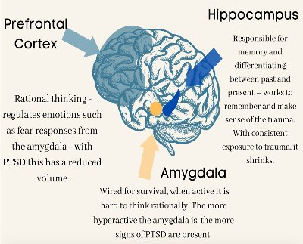
Trauma and the Brain

Slide 34
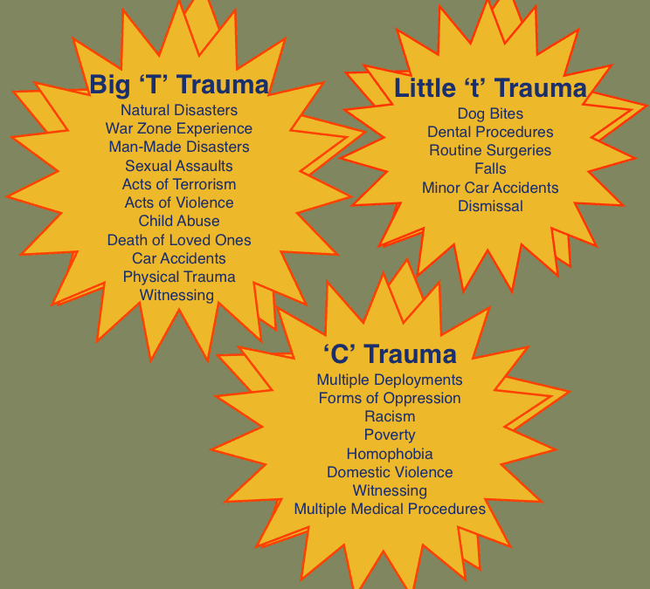
Some Types of Trauma

Slide 35
Trauma can appear as:
Psychological and physiological response to an experience involving the threat of or actual violence.
Flashbacks
Overwhelming emotional and physiological responses
Numbing
Disassociation
Can affect well-being and interfere with participation in hearing process.
Difficulty with attention, concentration and memory
Guardedness
Difficulty trusting
Depression
Isolation
Stomach and physical ailments

Slide 36
How do we see this manifest in survivors?
Inconsistencies
Difficulty capturing and retaining memories
Non-Linear
Difficulty recollecting details of memories
Fragmented
Flat affect/voice
Tears
Inappropriate Laughter
Shaky voice
Dry mouth
PTSD/panic attacks mid-hearing.
This does not mean that the person speaking does not care about what they are saying.

Slide 37
Hearing Panel- How do we engage in a trauma-informed way?
Provide clear directions on process.
  Surprises that can be avoided can be unnecessarily unnerving for both claimants and respondents.
Provide Breaks
Consequences
  Provide information about what consequences will be in place if participants to not adhere to process, lack decorum etc.

Slide 38

Hearing Panelists- How do we participate in a trauma-informed way?
Make sure to check for approval from chair when asking a question.
Keep reactions to both parties neutral.
Try not to be repetitive with questions- particulary triggering questions.
  Why do you feel you need to ask again?
Remember how vulnerable respondents and claimants probably feel.
  Stakes are high. (expulsion, fear of retaliation, invalidation, etc)
  Speaking about something they may only have told a few close people and those involved with the Title IX hearing.

Slide 39
Universal Trauma-informed Evidentiary Decisions
NOT permitted
  Sexual history of Complainant (Rape Shield)
  Privileged communications
  Medical documentation

Slide 40
Trauma informed Do’s and Dont’s
Do: Make your zoom space calming and neutral.
  Avoid backgrounds with phrases/images that could be misinterpreted.
Don’t: Ask about Claimant’s prior sexual behavior. (Rape Shield Protection) It is not admissible unless questions and evidence are offered or the sexual behavior is in respect to the respondent and are offered to prove consent.
Do: Read the entire investigation thoroughly so as to not ask questions that have been addressed already.
Don’t: Assume all claimants have involved law enforcement.
Do: Understand that some people do not report for a while because they are scared.

Slide 41
Off Campus Information
Claimants can pursue justice on-campus, off-campus, or both. Does not mean that law enforcement has automatically been called.
Criminal Court cases can last much longer with no information that can assist on campus.
If Claimant went to the hospital, they may: Get a SAFE Exam, Get a checkup to assess any injuries/receive aftercare, or both.

Slide 42
SAFE Exam
SAFE Exams
  Sexual Assault Forensic Exam (formerly called a “rape” kit)
  Exam is done by Sexual Assault Nurse Examiner (SANE).
  Kit is not processed to find evidence unless claimant is pressing charges with law enforcement.
  Kits can stay in Albany indefinitely.

Slide 43
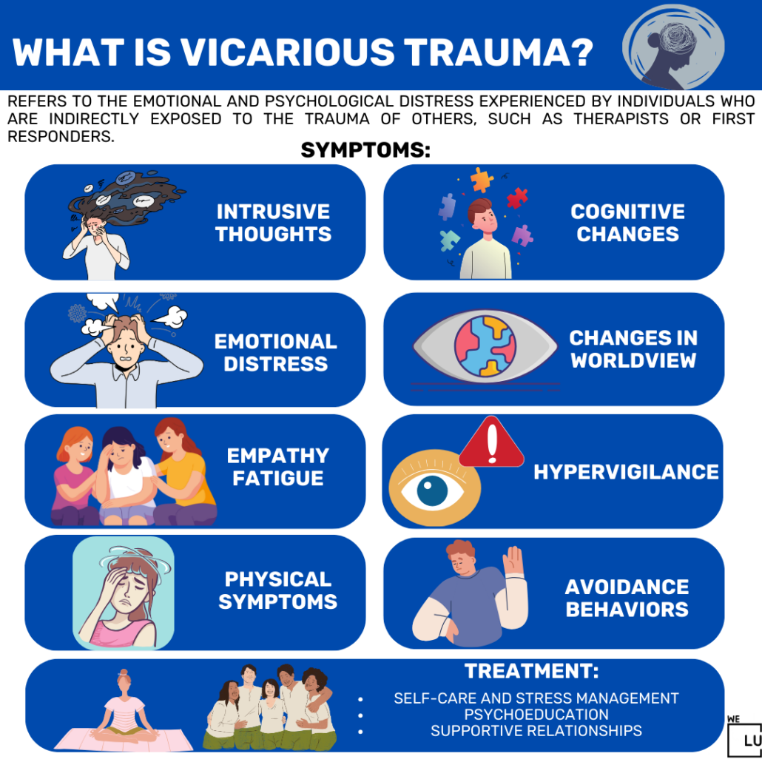
Vicarious Trauma

Slide 44
Questions?
Tam Cacchione
Insta: SaferHudsonValley
Tcacchione@familyservicesny.org
(845)452-1110 x3411

Slide 45
Know any faculty/staff interested in joining hearing panels?
Have them reach out!
Kelli Campa
Kelly Yough
kelli.campa@marist.edu
x2516
kelly.yough@marist.edu
x2210

Slide 46

Thank You!
46

