Slide 1
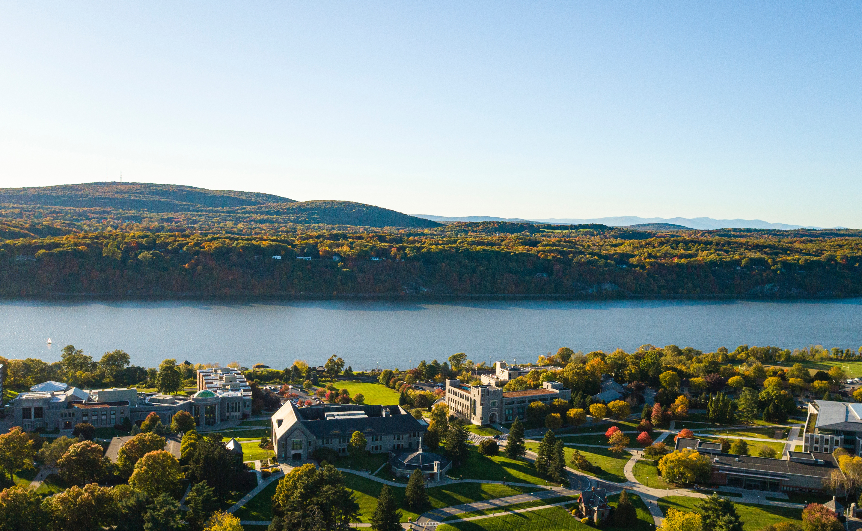

HEADLINE
Sub Headline
Notes:
Photos throughout the template are meant to be for placement and can be replaced based on the content of the presentation. To change an image, follow these steps: Click on an image; right click; select “Change Picture”; select “From File”; click on the photo name from your folder; select “Insert.” To resize a photo, follow these steps: Click on an image; right click; select “Crop”; resize picture box by clicking and dragging the bold handles; click and drag corners of the photo to resize the image.

Slide 2



CHAPTER SLIDE HEADLINE
Sub Headline
2

Slide 3

CHAPTER SLIDE HEADLINE
Sub Headline
3

Slide 4
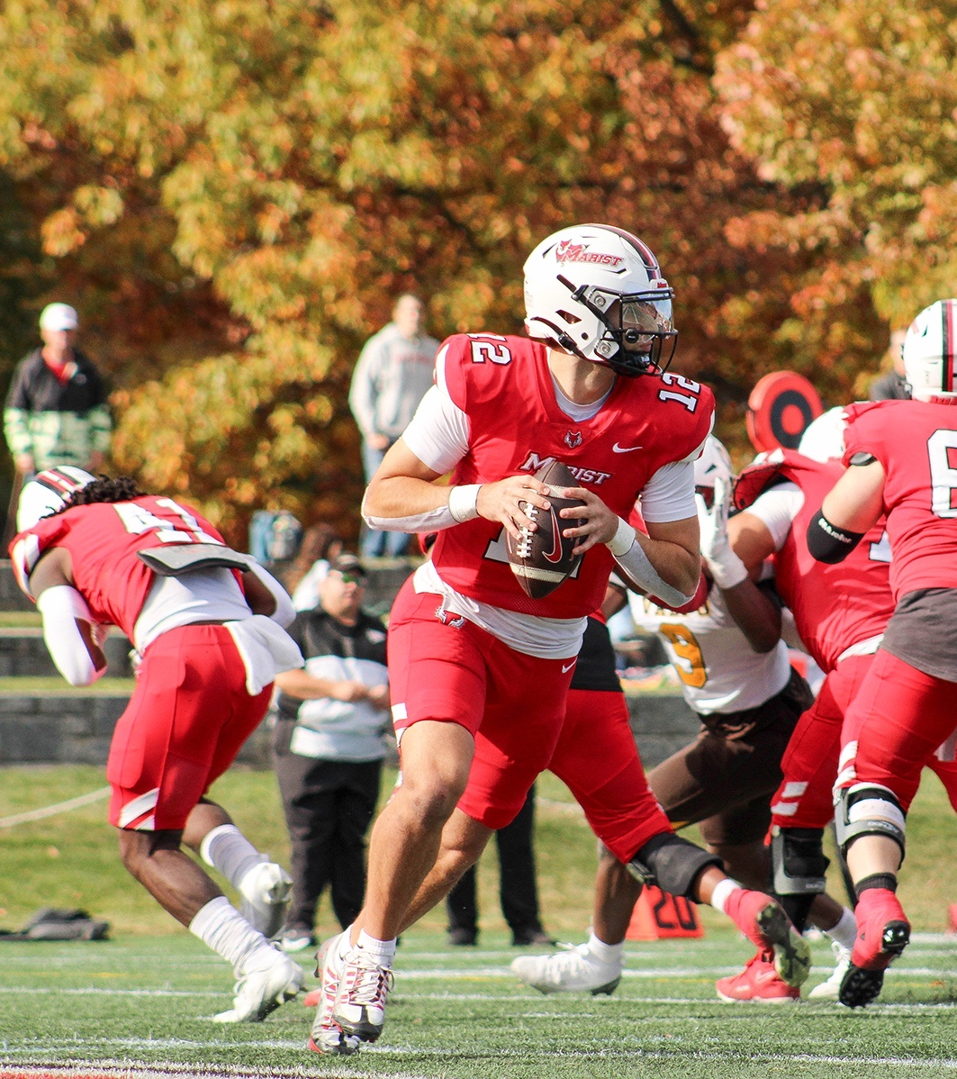
CHAPTER SLIDE HEADLINE
Sub Headline
4

Slide 5
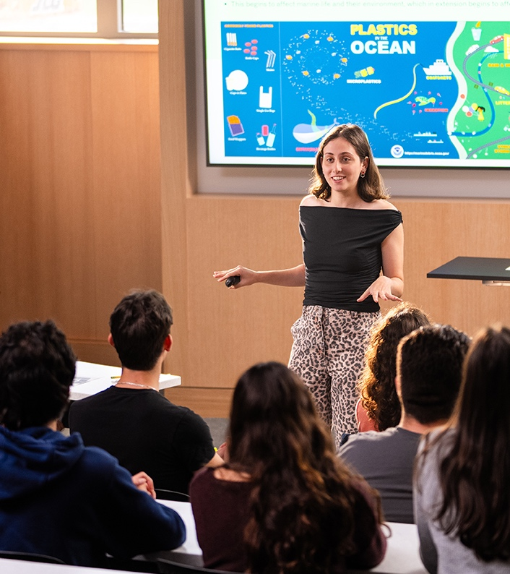
CHAPTER SLIDE HEADLINE
Sub Headline
5

Slide 6
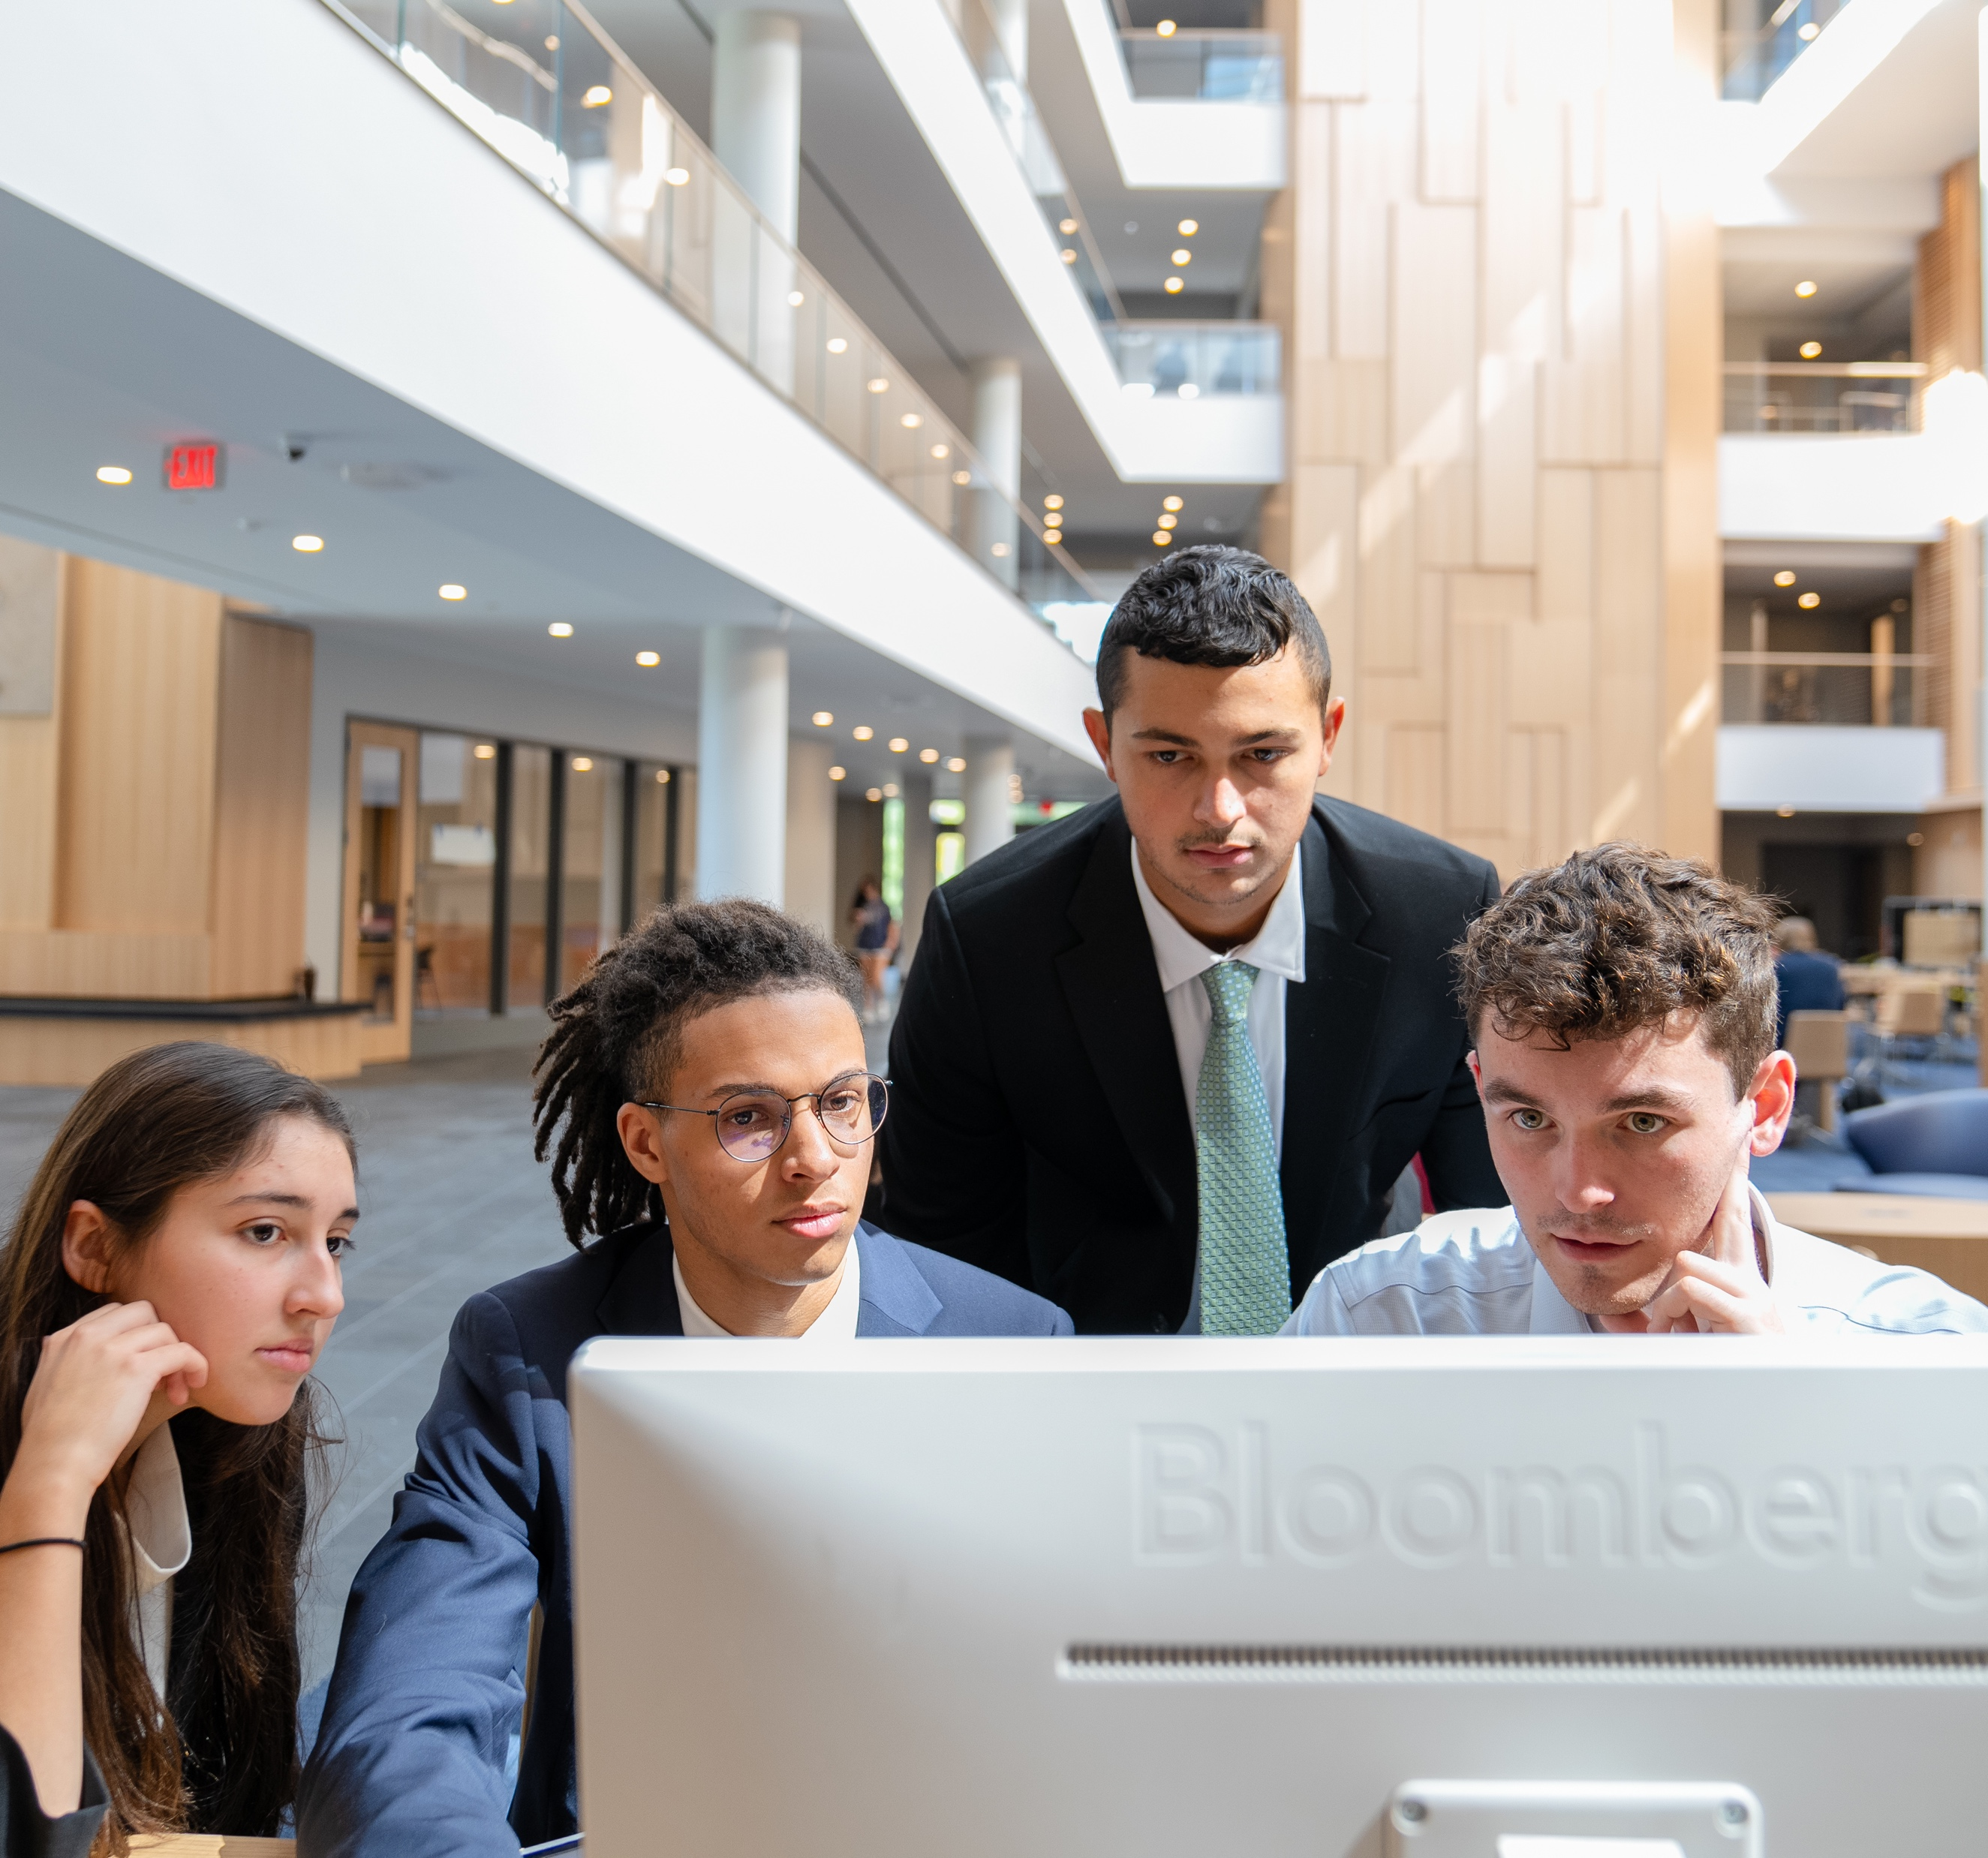
HEADLINE
SUB HEADLINE
Aquate nihillabor at eos etur molore pres etum rate. Aquate nihillabor at eos etur molore pres etum rate ped unt.
Aquate nihillabor at eos etur molore pres etum rate ped.
Aquate nihillabor at eos etur molore pres etum rate.
IMAGE
6

Slide 7

HEADLINE
Content
Content
Content
Content
Content
7

Slide 8
HEADLINE
SUB HEADLINE
Aquate nihillabor at eos etur molore pres etum rate. Aquate nihillabor at eos etur molore pres etum rate ped unt.
SUB HEADLINE
Aquate nihillabor at eos etur molore pres etum rate. Aquate nihillabor at eos etur molore pres etum rate ped unt.
SUB HEADLINE
Aquate nihillabor at eos etur molore pres etum rate. Aquate nihillabor at eos etur molore pres etum rate ped unt.
8

Slide 9
HEADLINE
SUB HEADLINE
Aquate nihillabor at eos etur molore pres etum rate ped unt.
Aquate nihillabor at eos etur molore pres etum rate ped unt.
Aquate nihillabor at eos etur molore pres etum rate ped unt.
Aquate nihillabor at eos etur molore pres etum rate ped unt.
SUB HEADLINE
Aquate nihillabor at eos etur molore pres etum rate ped unt.
Aquate nihillabor at eos etur molore pres etum rate ped unt.
Aquate nihillabor at eos etur molore pres etum rate ped unt.
9

Slide 10
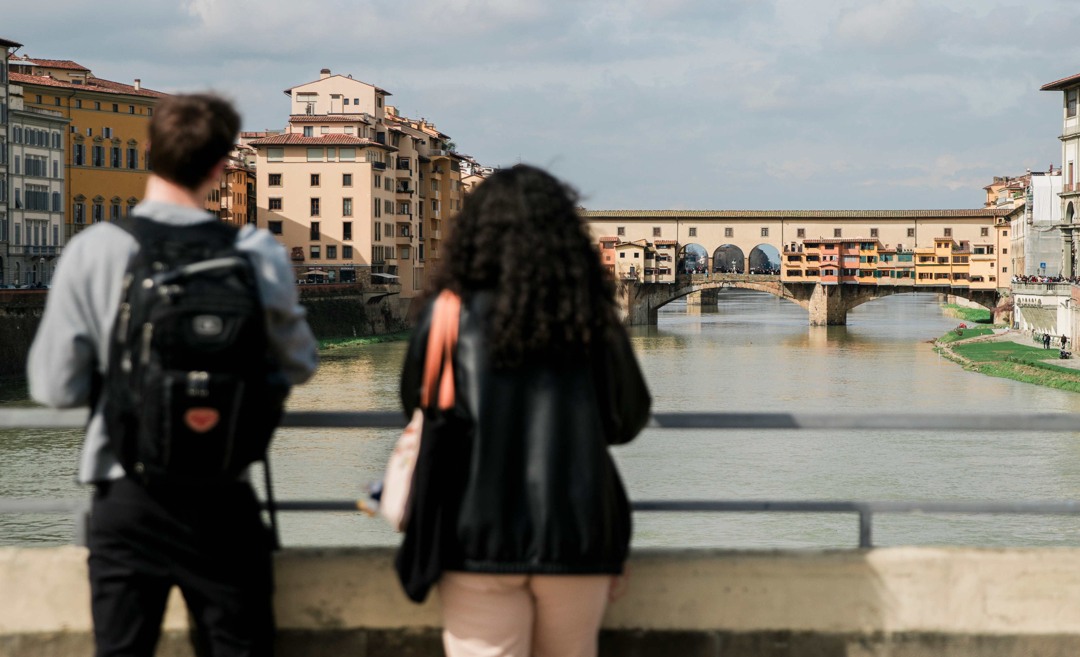
HEADLINE
#1
Semester
Abroad
Programs
Open Doors Report
10
Notes:
This page is an example of the style for statistics to be highlighted. To change the background photo, see “Notes” on slide one (1).

Slide 11
HEADLINE
11
Notes:
The graphs on slides eleven (11) and twelve (12) are examples of the secondary and tertiary colors that can be used for graphs, charts, and tables. Refer to the color palette on slide fifteen (15) for the color codes. To ensure the correct color is used, select “More Colors” from the color charts in the top menu and type in the code in Hex Color # under the RGB values.

Slide 12
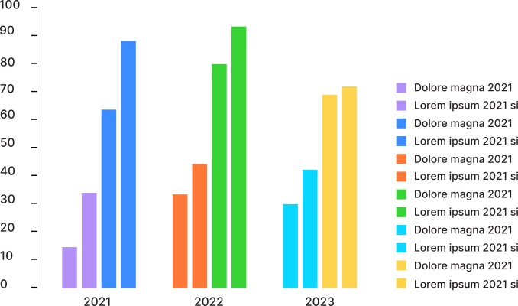
HEADLINE
12

Slide 13
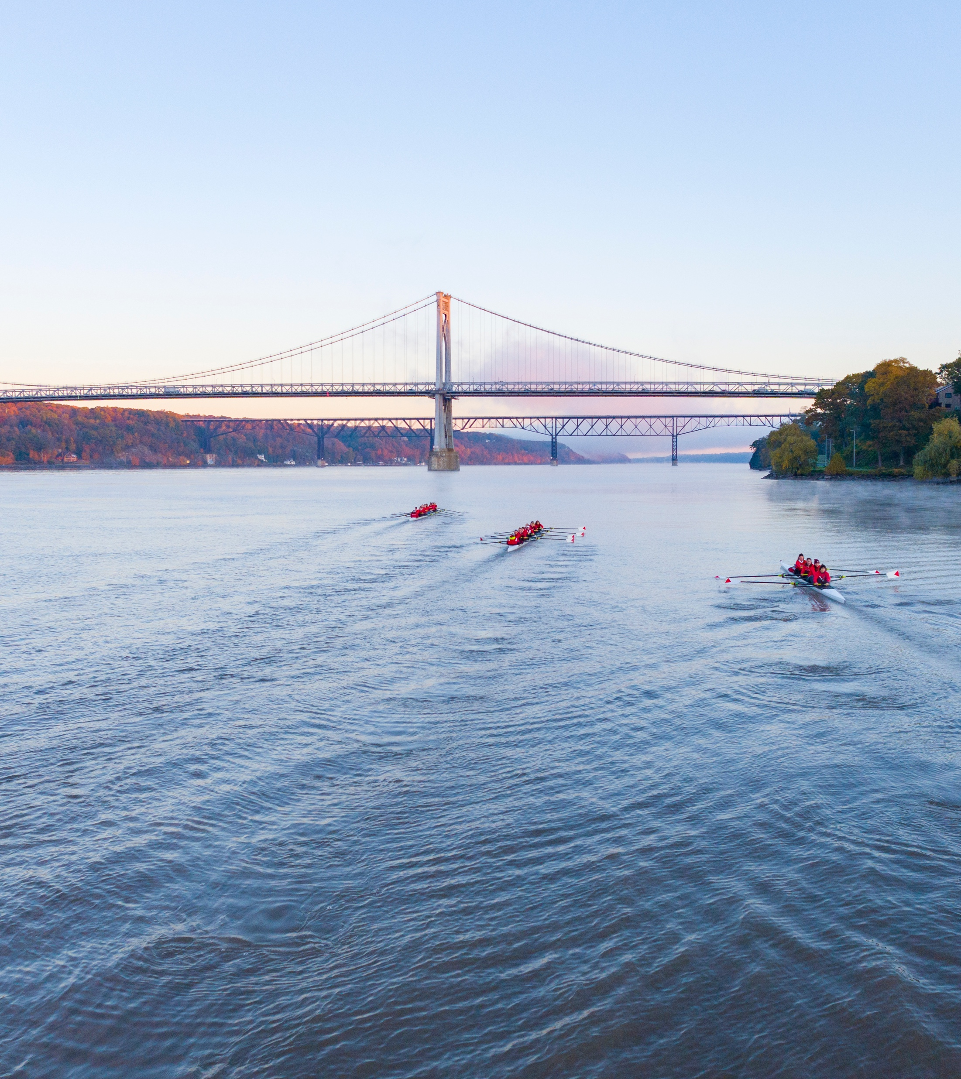
HEADLINE
Name, Title
Phone
Email
Name, Title
Phone
Email
13

Slide 14
THANK YOU

Slide 15
Color Palette
Primary Colors
Secondary Colors
C91235
63666F
FF2745
989AA5
B2B4BE
B2B4BE
D9DAE4
Tertiary Colors
B390F8
3C8CFF
FF7838
37D334
09D7FF
FED34C

